Slide 1
Climate Change
Greenhouse Gases
Global Warming
Notes:
The focus of this presentation is clarify the terminology, the science, and the consequences related to climate change.

Slide 2
Notes:
You have seen the news—wildfires, glaciers melting, sea level rising …

Slide 3
Notes:
extreme storms such as our recent tornado, flooding that delays the planting of crops, desertification,

Slide 4
Notes:
spread of disease, including new viruses.

Slide 5
Notes:
We’ve even experienced a heat wave in October and a 500 year flood, as well as a devastating tornado and the corona virus.

Slide 6
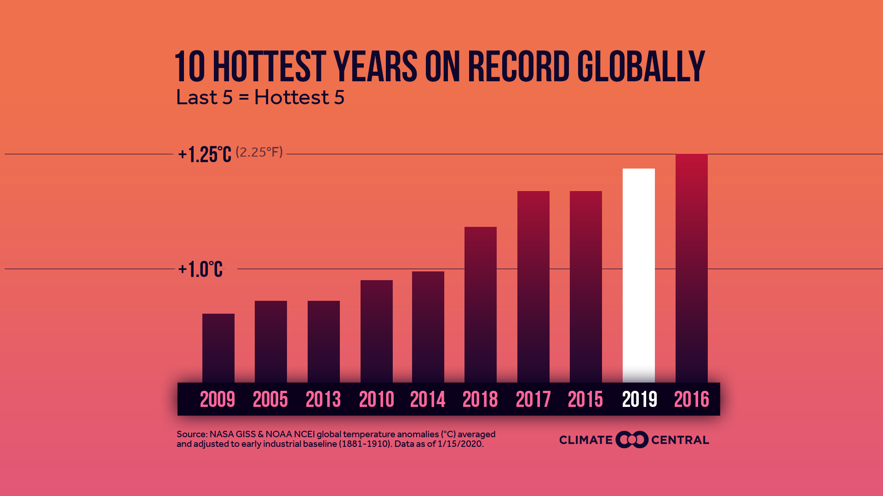
Notes:
We’ve experienced the 10 hottest years on record.
You’ve heard all these things attributed to climate change or global warming, but what is that? And how can that be when we still have snow and cold weather?

Slide 7
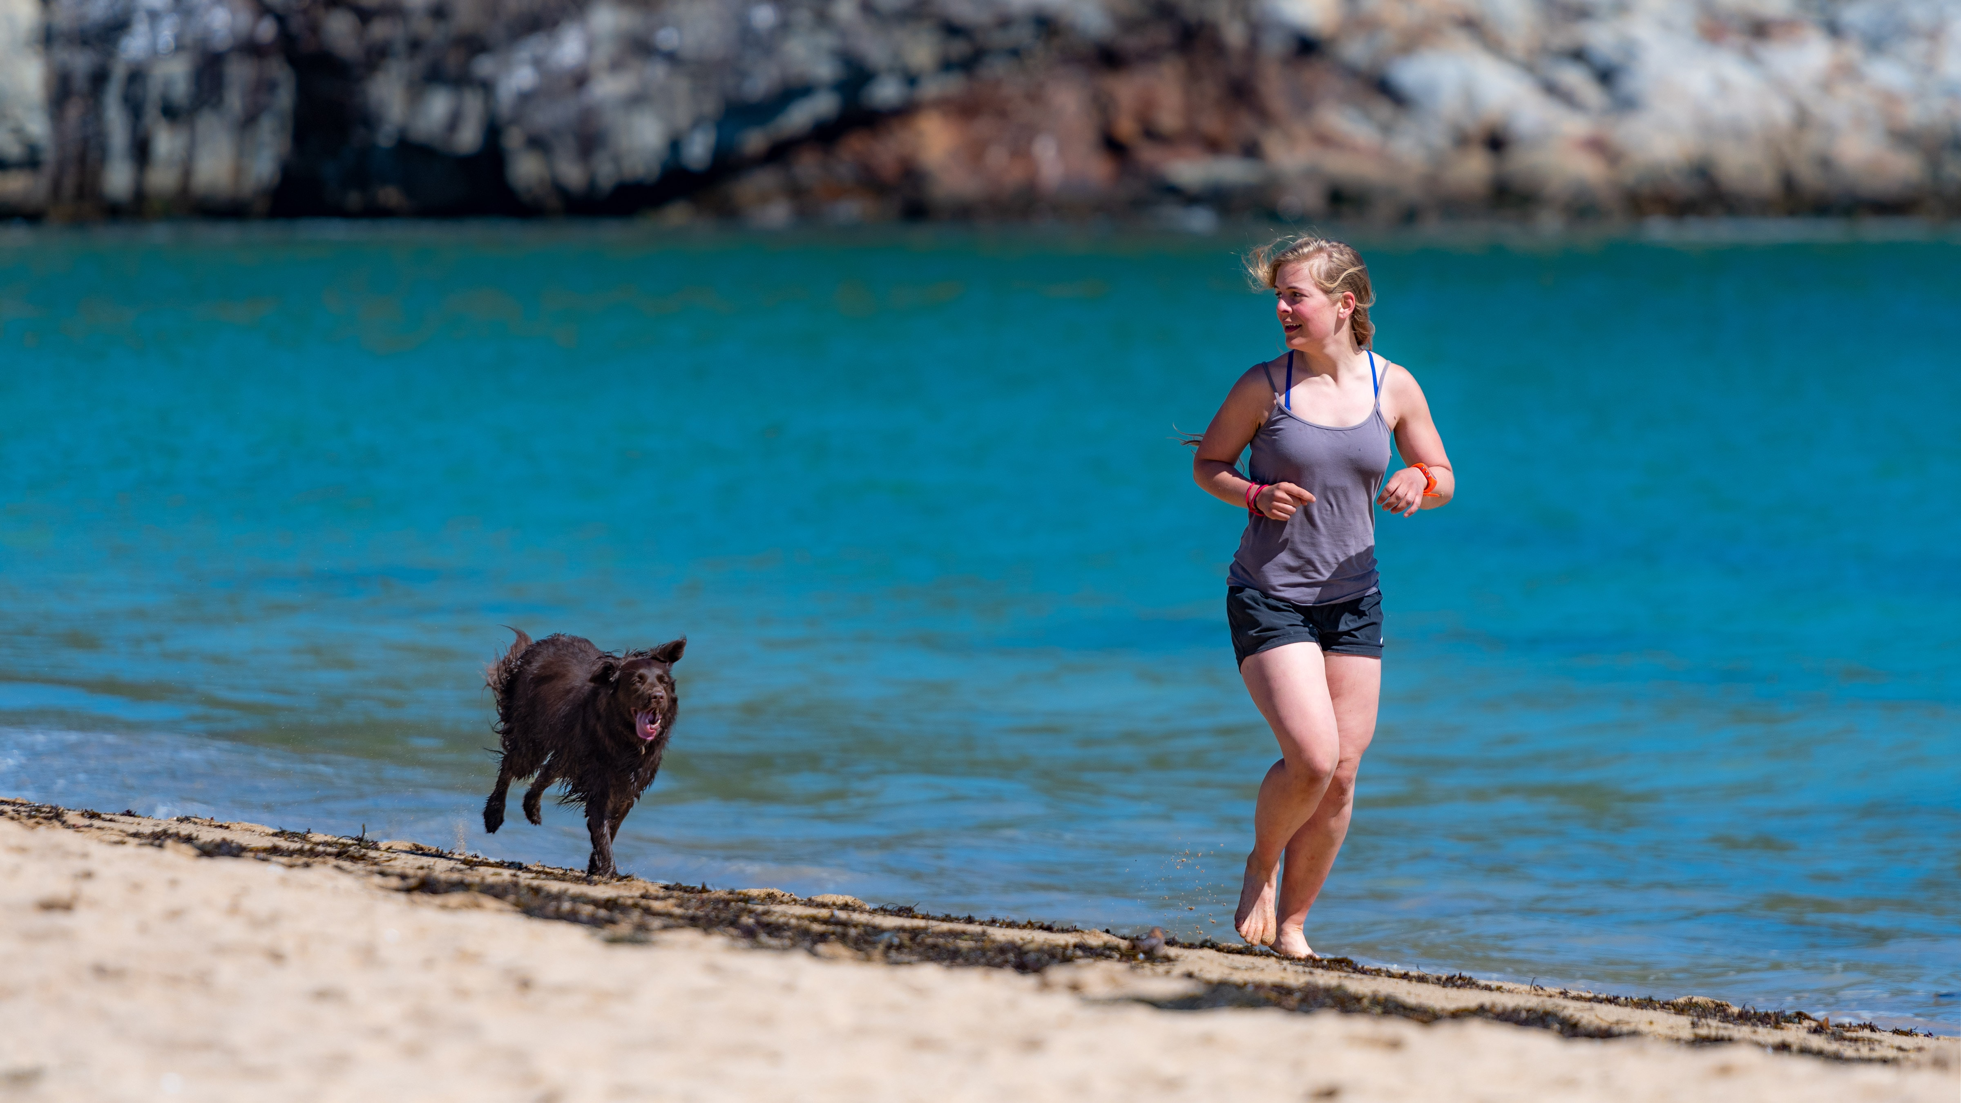
Climate
Imagine
Weather
Notes:
How many of you have ever had a dog?
Image taking a walk with a dog off leash. You may be headed in one direction, but the dog? Erratic! Zig zags! Ahead one minute and behind the next. But the dog is still basically tracking "with" you.
Think of climate as the one who is on a steady course. The dog, however, is like weather!
Another way to think of the difference is that weather is short-term and climate, long-term.

Slide 8
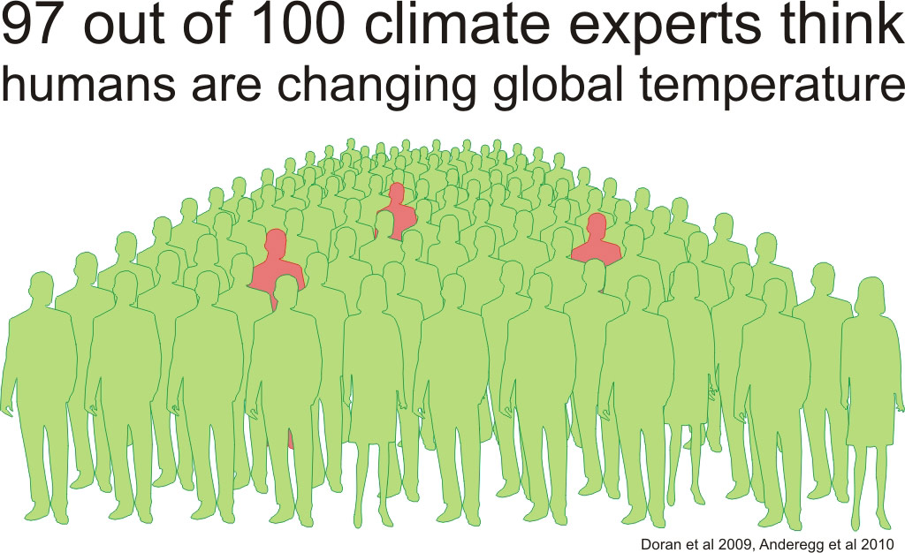
Notes:
You may have still have questions, but 11,000 scientists globally who study climate are in agreement.
This graph from 2009 shows 97% of all climate scientists concur that our climate is changing and it’s due to human activity affecting Greenhouse Gases. However, by 2015 the number of scientists who agree had risen and is now 99.9%.

Slide 9
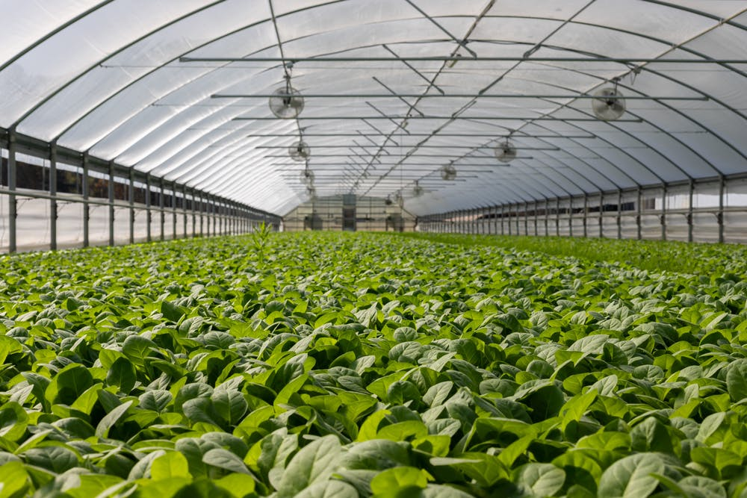
Increased Greenhouse Gases →Global Warming →Climate Change
Notes:
Let’s unpack: Think of a blanket at the outer edge of Earth’s atmosphere. The blanket is made up of what are called “Greenhouse Gases.”
As in a greenhouse, they let solar heat in and hold some of it, making life on Earth possible by keeping the planet from freezing.
However, the GHGs also trap heat in from the other direction, from Earth. When the GHGs, like a blanket, become too heavy, the additional heat then bounces back and overheats the atmosphere and oceans, producing global warming, which then produces climate change.
Increased Greenhouse Gases lead to Global Warming, which leads to Climate Change.

Slide 10
Greenhouse Gases
Carbon Dioxide (CO₂)
Notes:
5 elements make up GHG: 3 are relatively small (Water vapor, Nitrous Oxide in fertilizer, and fluorinated gases that replaced Ozone-destroying chemicals.
The other 2 are the most potent:
CO2, which comes from burning of fossil fuels—coal, oil, gas—for generating energy to power our homes, businesses, and vehicles. This element is the greatest contributor to GHG. Curbing our emissions is essential.

Slide 11
Methane
Notes:
The other major contributor is Methane, which is less in volume and, although it doesn’t linger as long in the atmosphere, it is much more potent molecule for molecule than CO2. It also comes from oil and natural gas, including gas escaping during fracking or transport. The other sources of methane are landfills and livestock (beef, especially). So what you throw away and what you eat do matter.

Slide 12
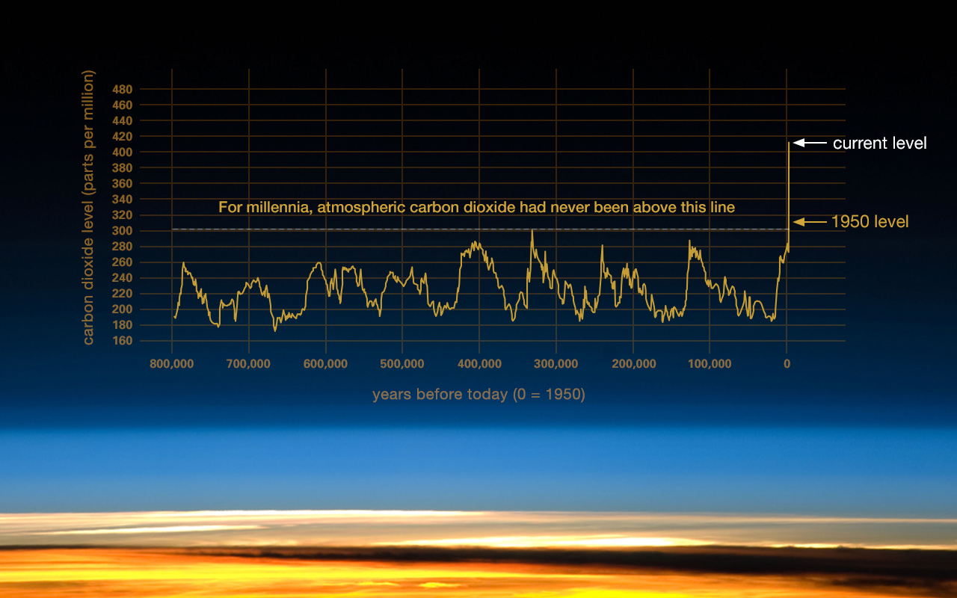
Notes:
BECAUSE THE GRAPH MAY BE HARD TO READ, TALK ABOUT THE ELEMENTS THERE—MILLENIA, CO2
NASA’s research shows the dramatic increase in GHGs in general—and of CO2 in particular— in the last 70 years.
And the upward trajectory is increasing at a much faster pace, which is cause for increasing alarm.

Slide 13
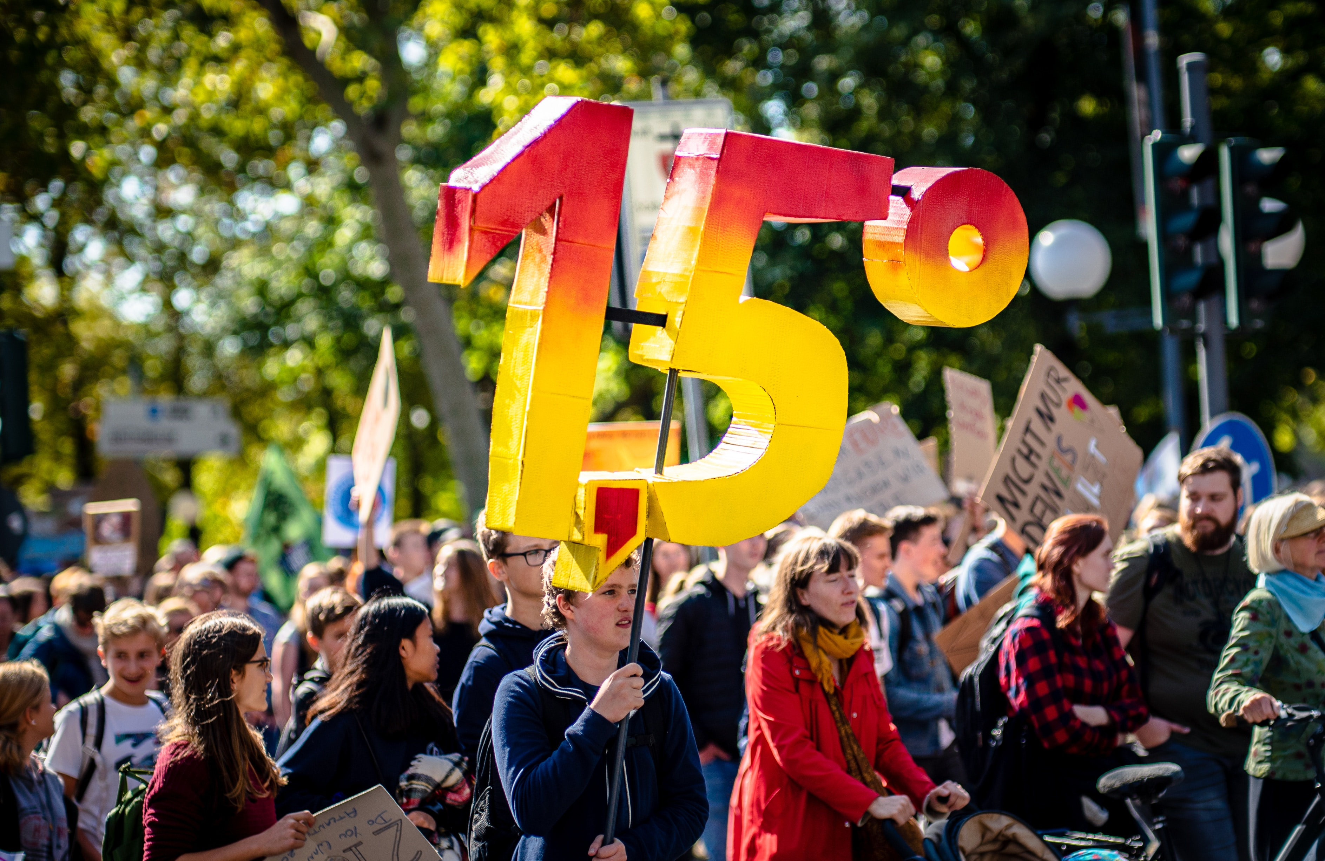
Notes:
Paris Agreement, in 2015, with all nations set the goal for keeping global warming at “well under 2 degrees Celsius.” Specifically, the aim is for 1.5 degrees Celsius.
We’re nearly at the top level and still increasing. Scientists give us only 10 years before we’re at a tipping point, when scientists project it may be beyond our capability to go back. By 2030 emissions need to fall by 45% from 2010 levels.
President Trump plans to pull the US out of the Agreement. Legally, he cannot do that until after the 2020 election. But the threat and the lack of action by the US has left a vacuum of leadership and significant damage to the momentum.
YOU MAY NEED TO POINT OUT THE FIGURE IS 1.5 DEGREES CELSIUS (THE POINT LOOKS LIKE A COMMA.)

Slide 14
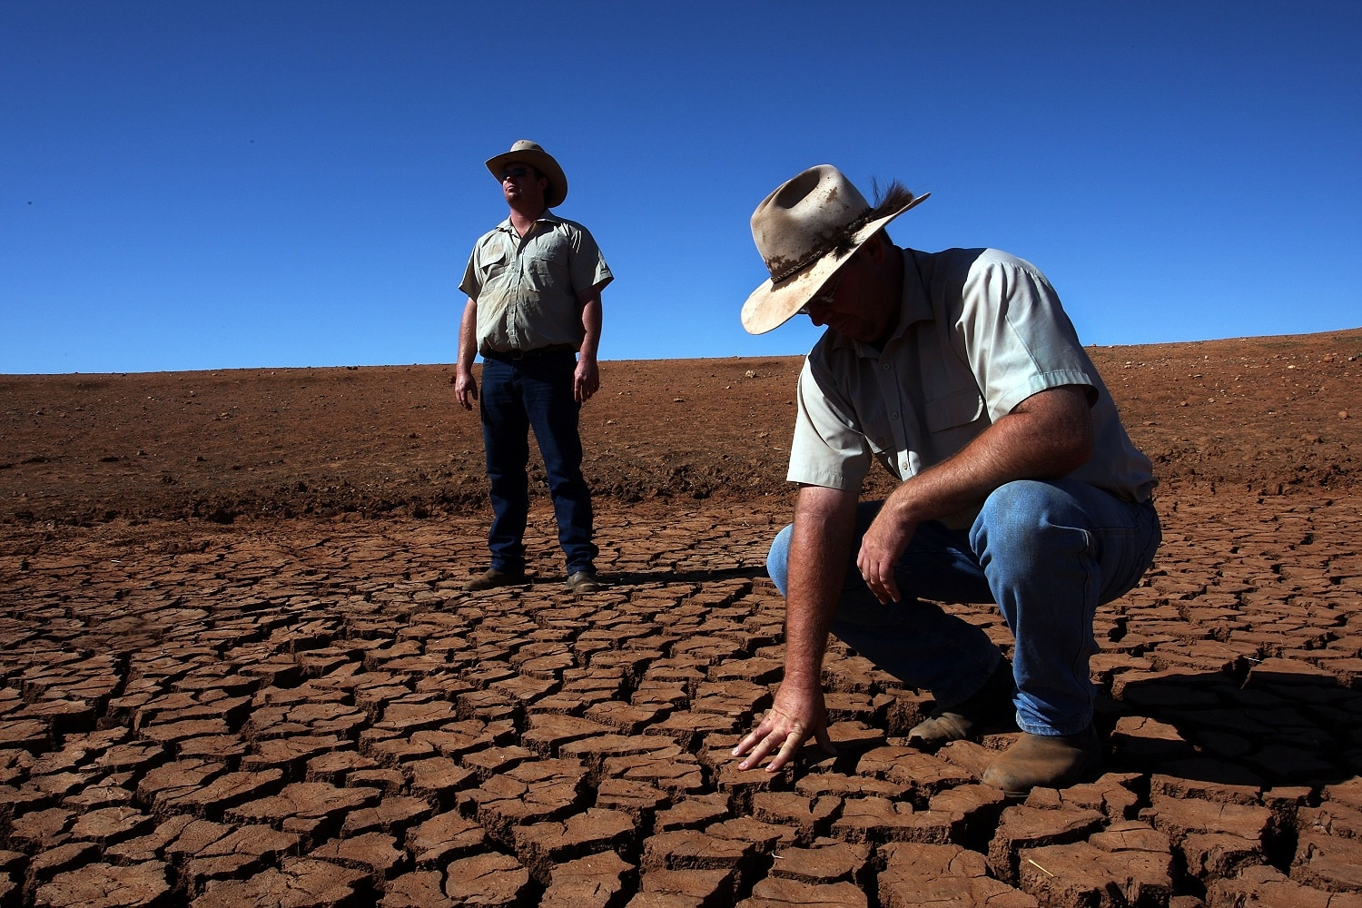
Drought
Notes:
We’ve already seen some of the consequences of global warming in the natural disasters and biodiversity losses, but climate change will also produce societal change that isn’t pretty!
The erratic weather with flooding and drought and higher temperatures interfere with being able to grow food.

Slide 15
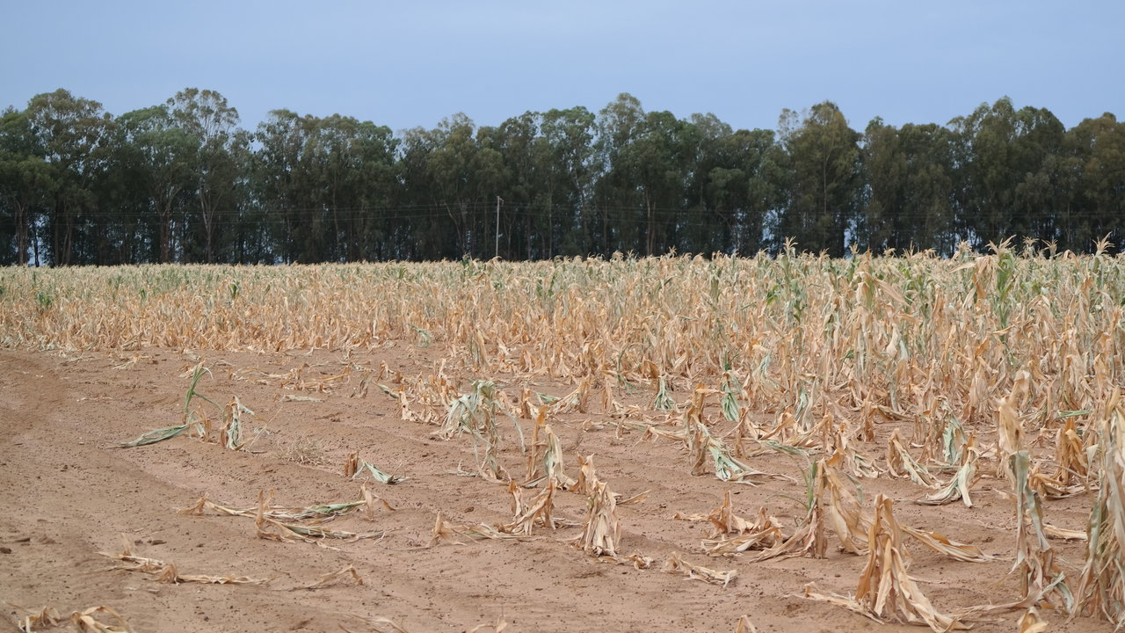
Food Scarcity
Notes:
Especially in developing countries, people who can no longer feed their families with their own farms or village cooperatives will suffer severe food shortages, malnutrition, and disease.
It gets worse.

Slide 16
Without Food Resources
Malnutrition & Disease
Mass Migration
Hoarding
Corruption Violence
Threatening life as we know it
Notes:
These "food refugees" then begin to migrate. But people in other places that have more resources will be hoarding, trying to keep their own families fed. You can see the trajectory. It’s already begun. Corruption and violence will rise.
You may have heard the statement that Global Warming poses an existential threat to civilization. The very existence of life as we know it will be adversely affected.

Slide 17
Solutions
Big!
HR 763—Energy Innovation & Carbon Dividend Act
Government— International, national, state, local community
Corporations & Businesses
Notes:
There are solutions! Some require political will and big investments. But opportunities for change are at all levels of government.
House Resolution 763, which is focused on transitioning our economy away from burning fossil fuels, is one example of legislation that we can support at the federal level. Also, numerous cities and states are committing to renewable energy, Including Metro (reducing emissions by 40% by 2030 and 80% by 2050).
Even in the big challenges and big opportunities, you and I can play a part in influencing those entities to act. We have voice and vote!
Corporations and businesses can create new products, policies, and practices. We can speak up, and we vote with our buying power. We have influence.
YOU MAY NEED TO TALK ABOUT HR 763 TO EXPLAIN IT FURTHER.

Slide 18
Seemingly Small Churches Individuals Families
All of Us working for the common good
Notes:
Sometimes, when we recycle or choose a meatless meal or carpool, it doesn’t seem like much. But it is. All of that counts! Every day.
Our seemingly small efforts both make a contribution and become an example, encouraging others to act.
To be faithful stewards of the Earth, this gift from God, is our call. The ways are many! When we work together for the common good, we are being faithful.

