Slide 1
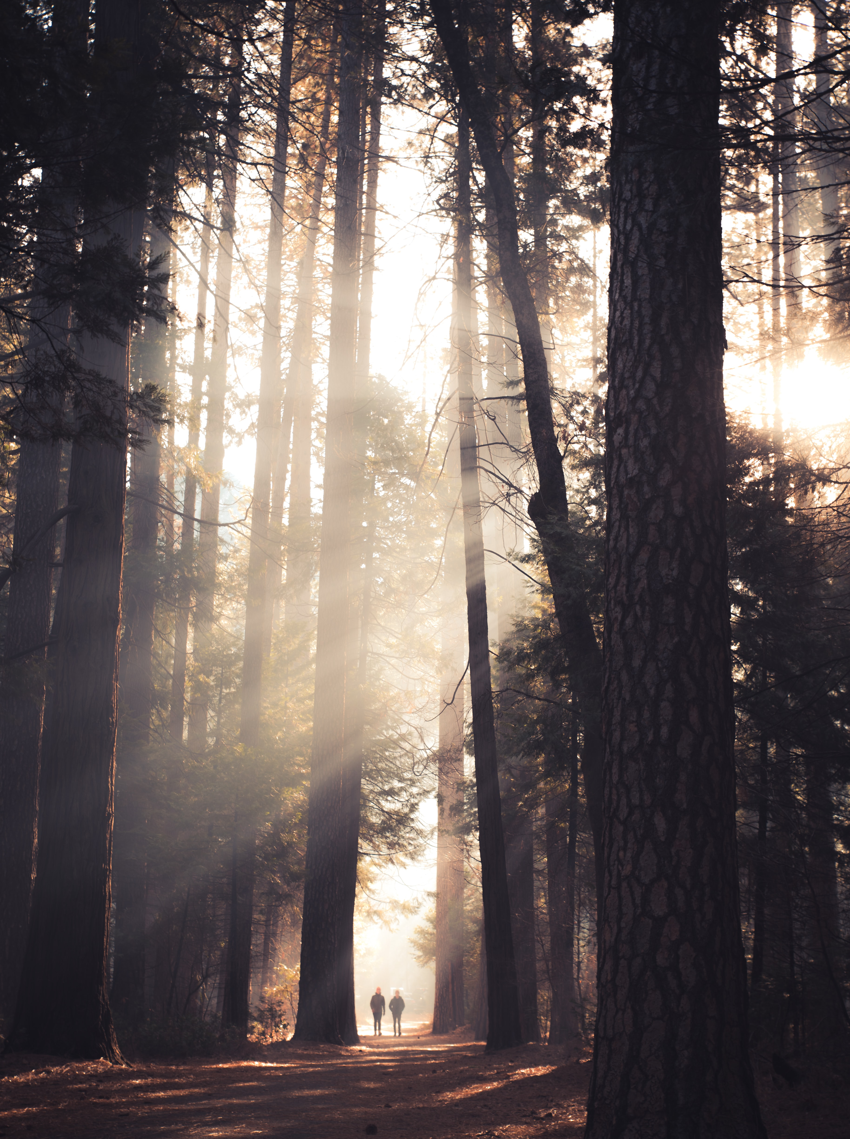
Planting for Now and for the Future
Notes:
You know that carbon emissions are the chief cause of global warming, which heats up climate change. And you know that burning fossil fuels (coal, oil, gas) for our energy and transportation needs is the chief cause of carbon emissions.
You may not have thought of the role of trees in global warming. The good news is that they can help mitigate the crisis of climate change.
The bad news is we have challenge before us!

Slide 2
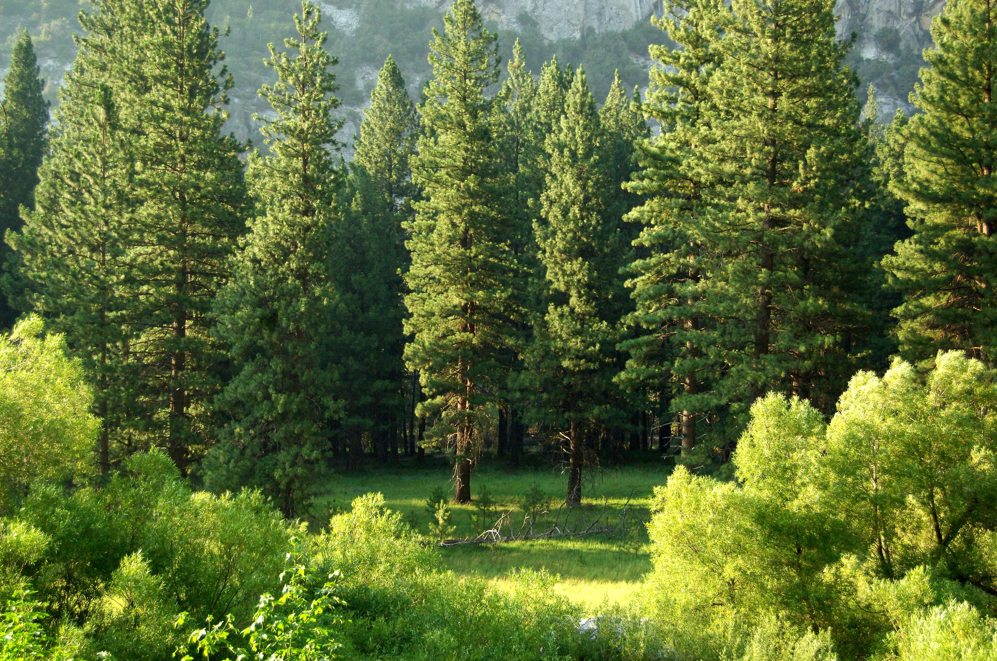
They breathe so we can breathe.
Notes:
Let’s look more closely at what trees do for the planet.
First, they inhale CO2 (about 48 pounds per year per mature tree), while they exhale oxygen (enough for a person to breathe for 2 years from the same tree). They breathe so we can breathe.
Secondly, they sequester carbon, pulling it into the soil where is stored and contributes to the health of the land. Trees are referred to as “carbon sinks.”

Slide 3
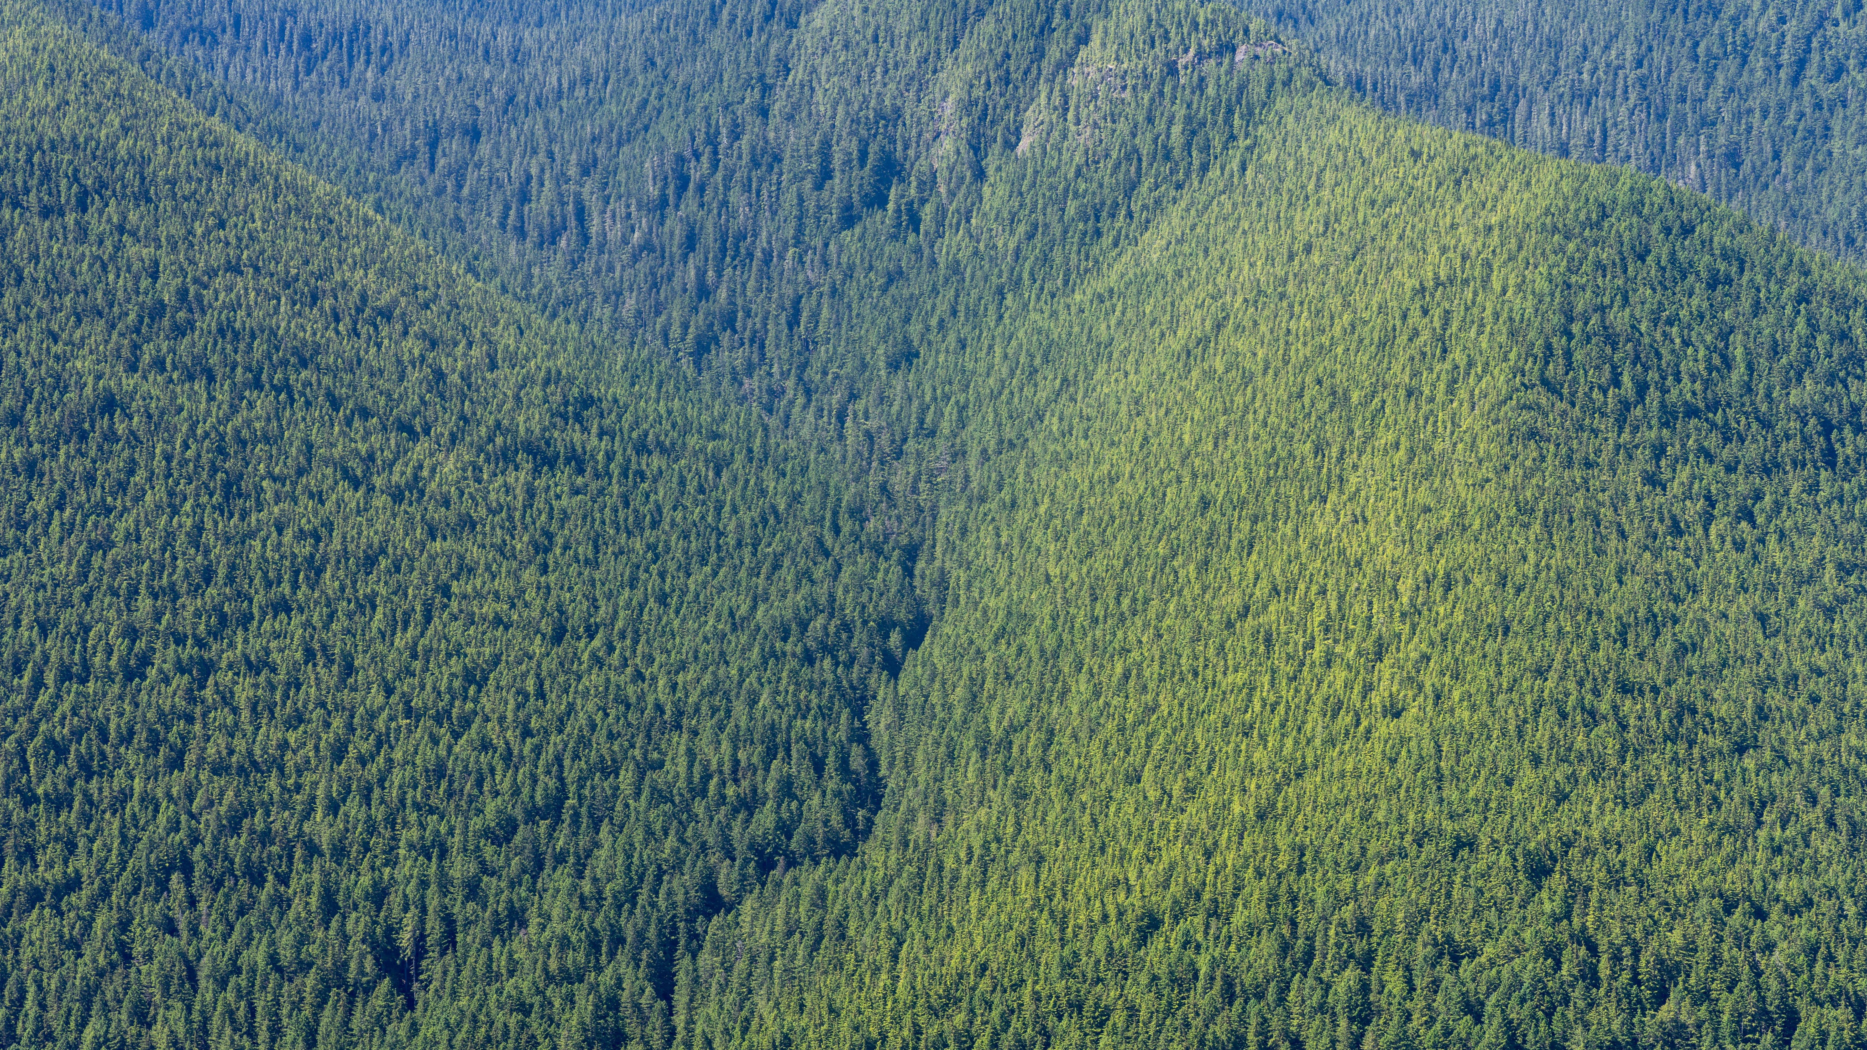
Earth’s “Lungs”
Notes:
On a larger scale, the great forests of the earth, such as the Amazon or the boreal forests of the North, are referred to as the “lungs of the earth.”
En masse what these humble trees do for us is equivalent to what our lungs do—they keep us alive.

Slide 4
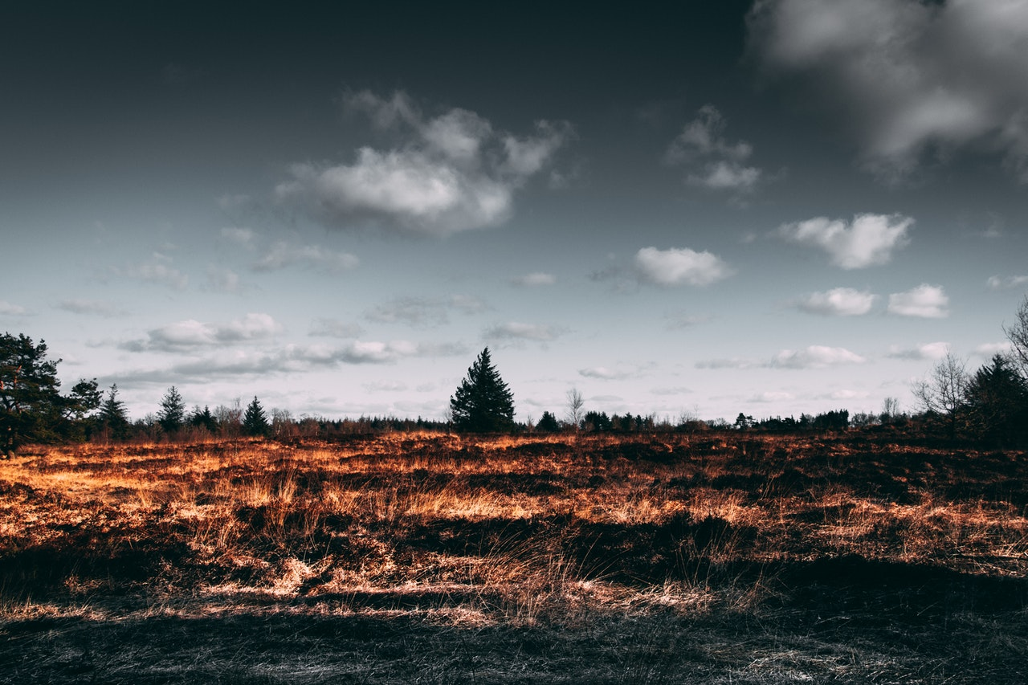
Our lungs are being diminished
Notes:
You know that people whose lungs are compromised by pollution or disease struggle with the basics of living. So it is with the earth. Our earth's lungs are being diminished.

Slide 5
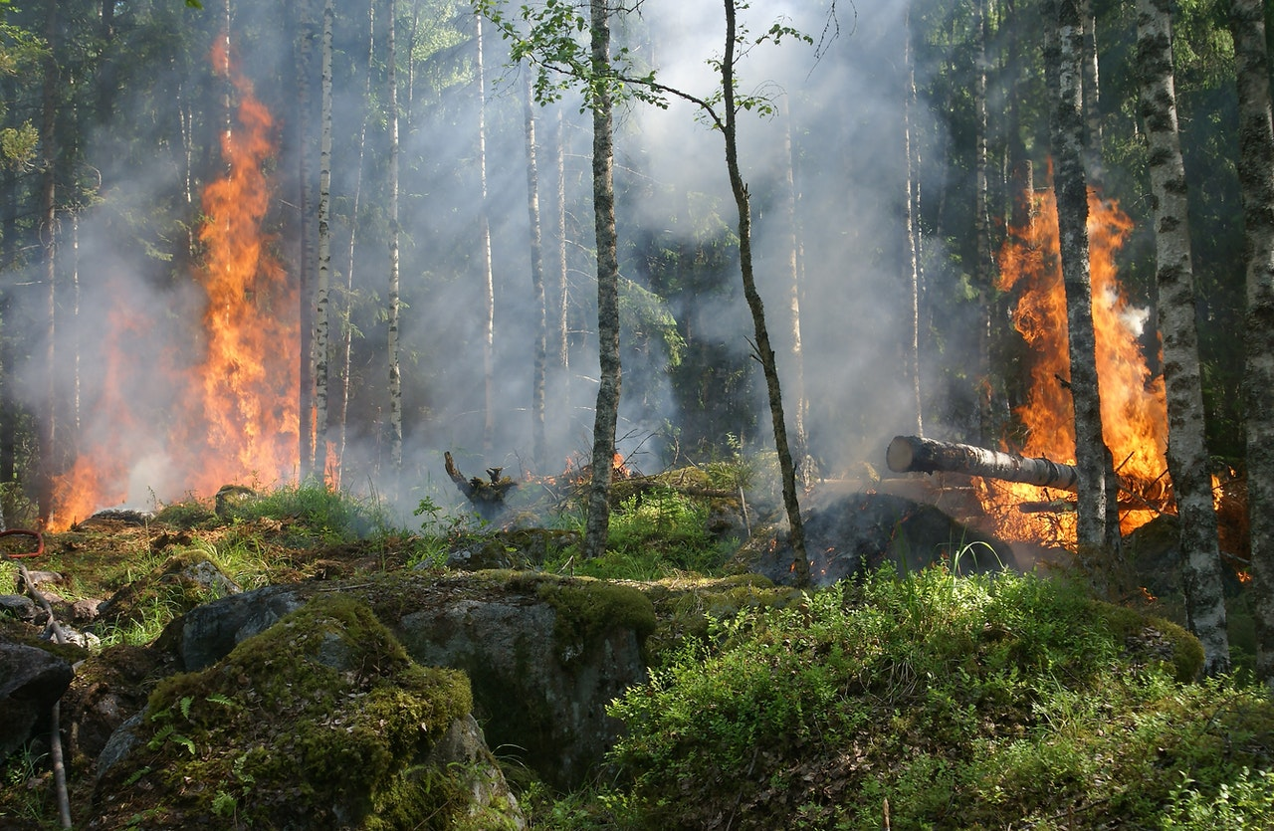
A Triple Whammy!
Notes:
When fire strikes, the loss is three-fold: Not only is carbon not absorbed nor sequestered, but also the burning of the trees releases more carbon into the air.
Yet, we have witnessed devastating fires in the Amazon, Australia, California, and even In our own Smokey Mountains, to name a few big-news ones.
Some fires have natural causes, such as lightning strikes.

Slide 6
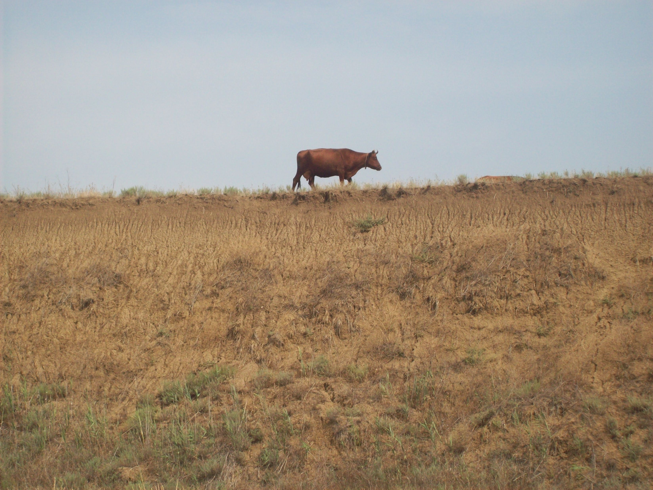
Notes:
But many result from human activity, including clearing land for farming. For example, the demand for beef has incentivized illegal slash-and-burn in forests of the Amazon for pasture to raise cattle for cash.

Slide 7
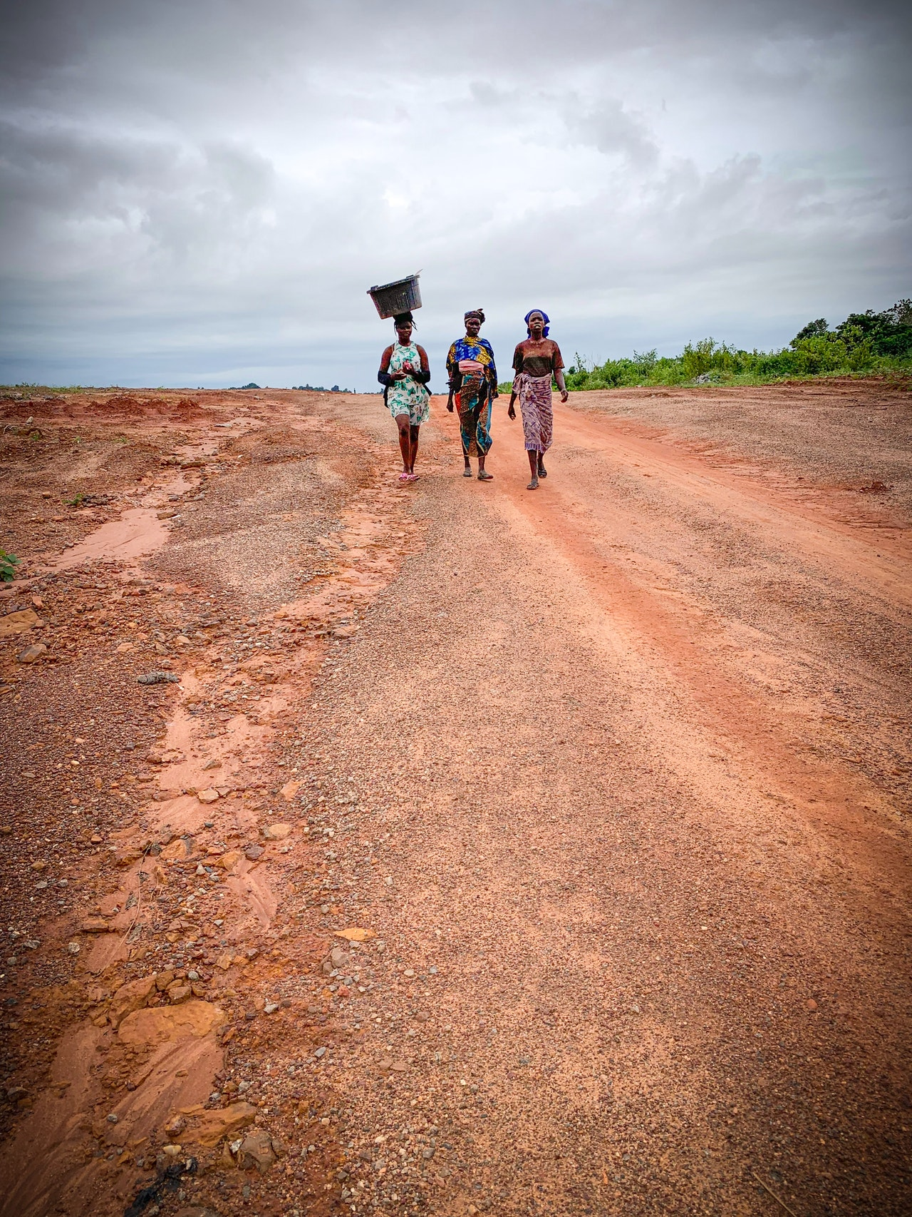
Deforestation
Consequences
Soil Degradation
Hunger
Violent Conflict
Notes:
In some developing countries, the need for firewood for cooking and heat and for timber to build shelters has over time denuded the land of its trees. The consequences of deforestation include soil degradation and erosion, resulting in hunger, and then violent conflict as warring peoples fight over scarce resources. Think of Syria, Yemen, South Sudan, and Afghanistan, for example, all of which are deforested.

Slide 8
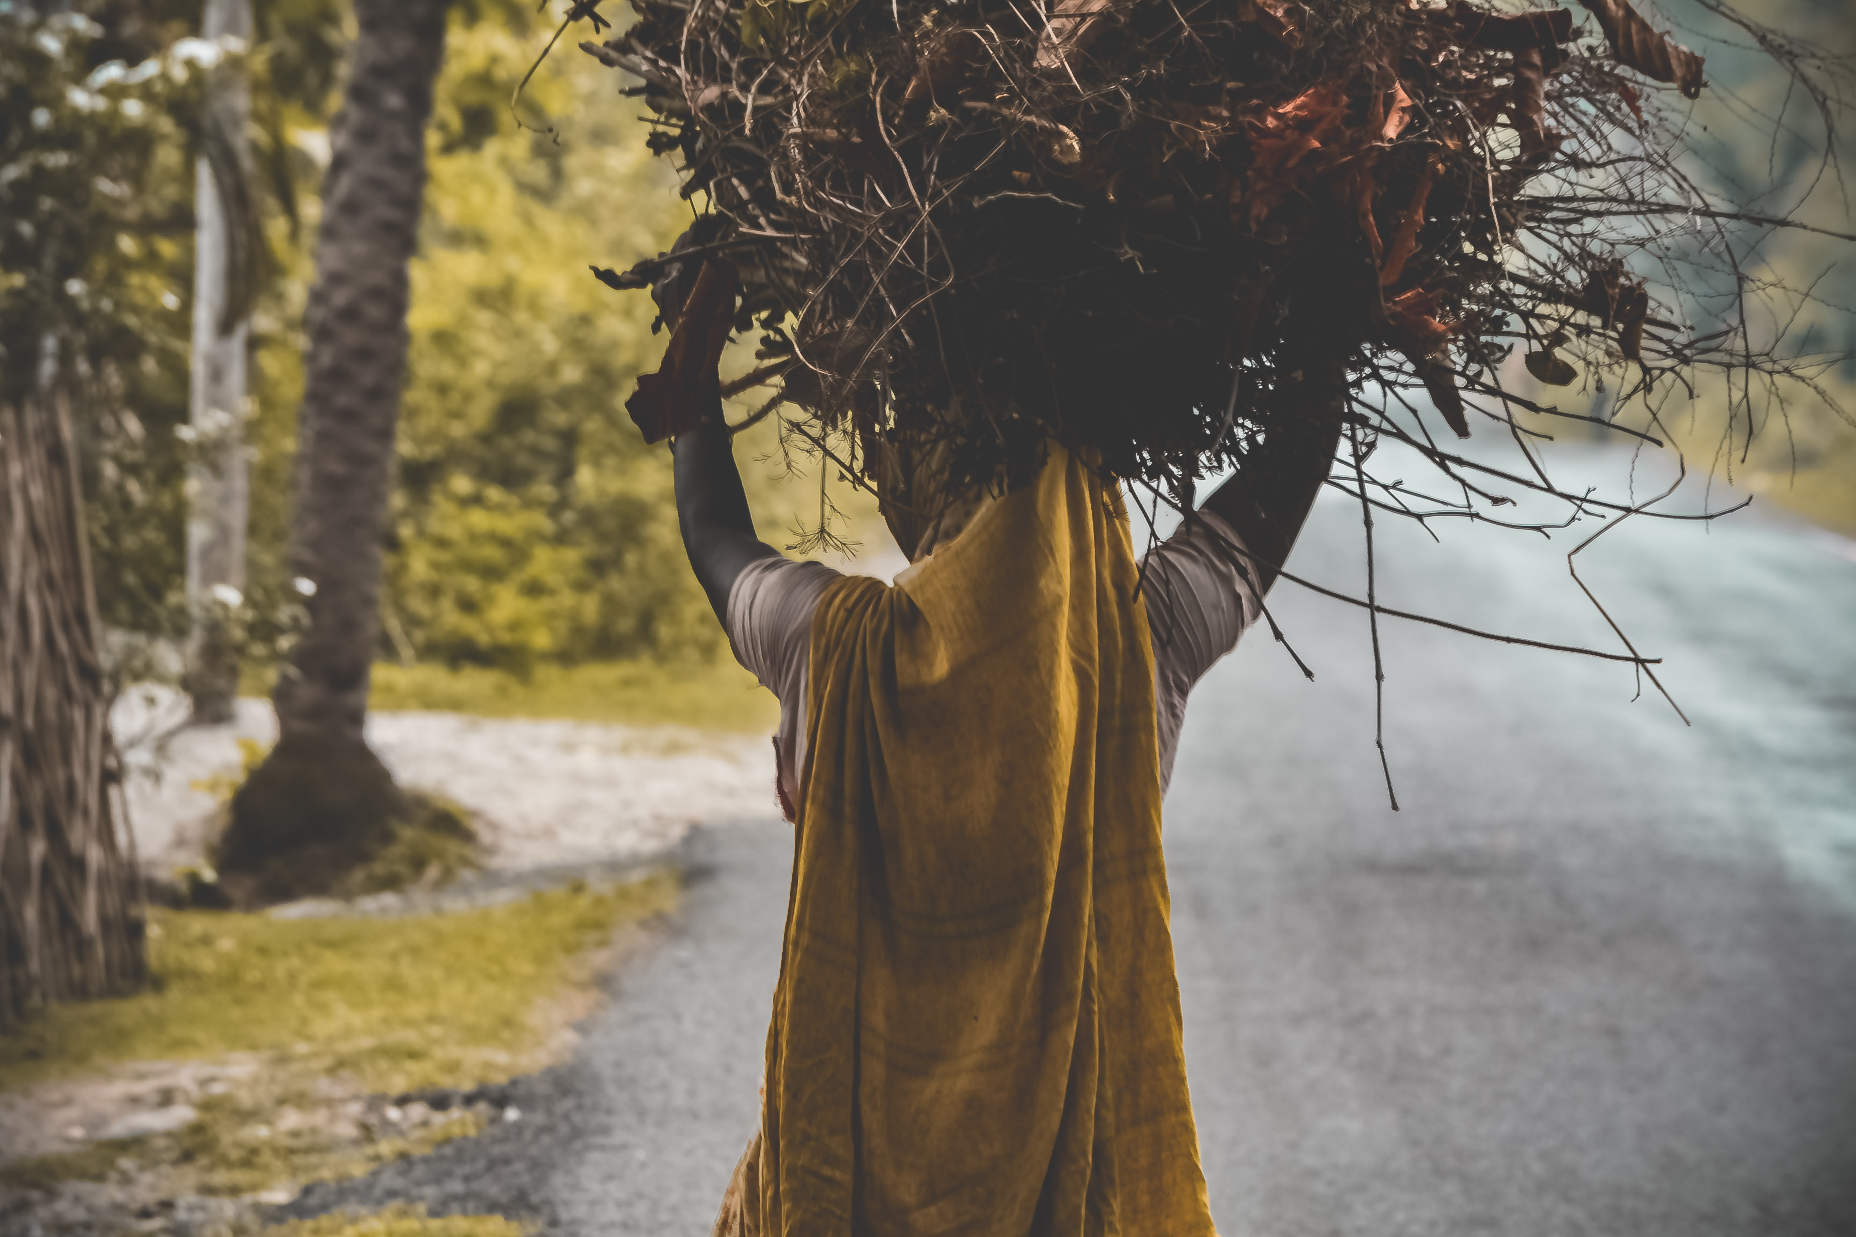
Notes:
Another little-known connection of deforestation is to the lack of education for women and girls. They are required to trek farther and farther away to bring back the essential wood for their community’s basic needs—at the cost of their own need for schooling and a more stable future.

Slide 9
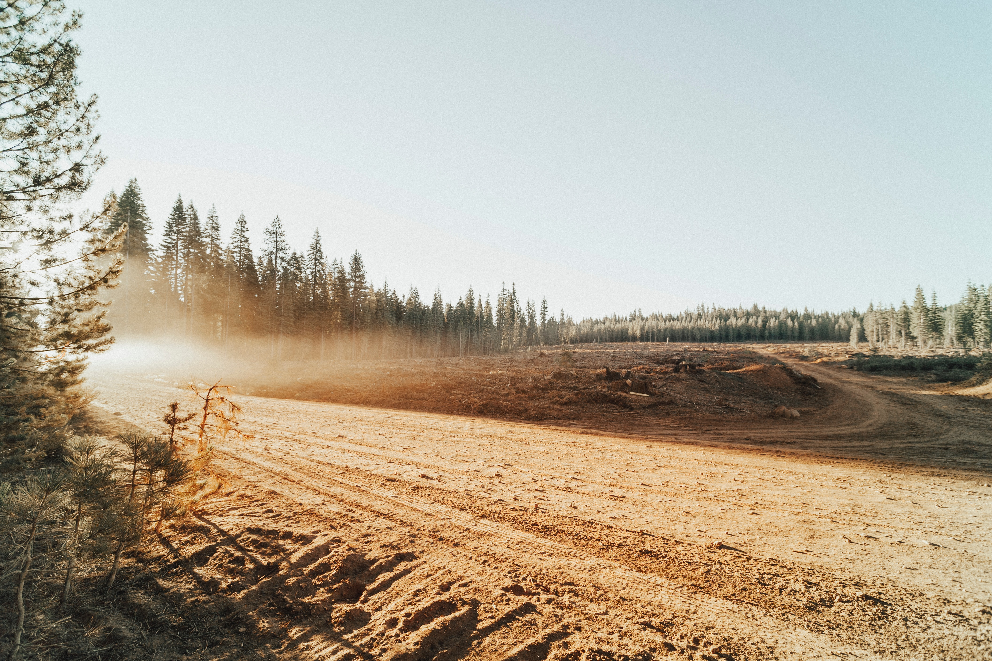
48 Football-field’s worth every minute!
LOST
Notes:
The scientists involved with Project Drawdown, an organization dedicated to identifying solutions to climate change, tell us that
Deforestation and associated land use change account for 15% of the world’s total output of carbon emissions.
Stopping all deforestation and restoring forest resources could offset up to 1/3 of all carbon emissions worldwide.
Yet, the world continues to lose 48 football-fields’ worth of forest every minute!
Clearly, loosing trees globally is a disaster.

Slide 10
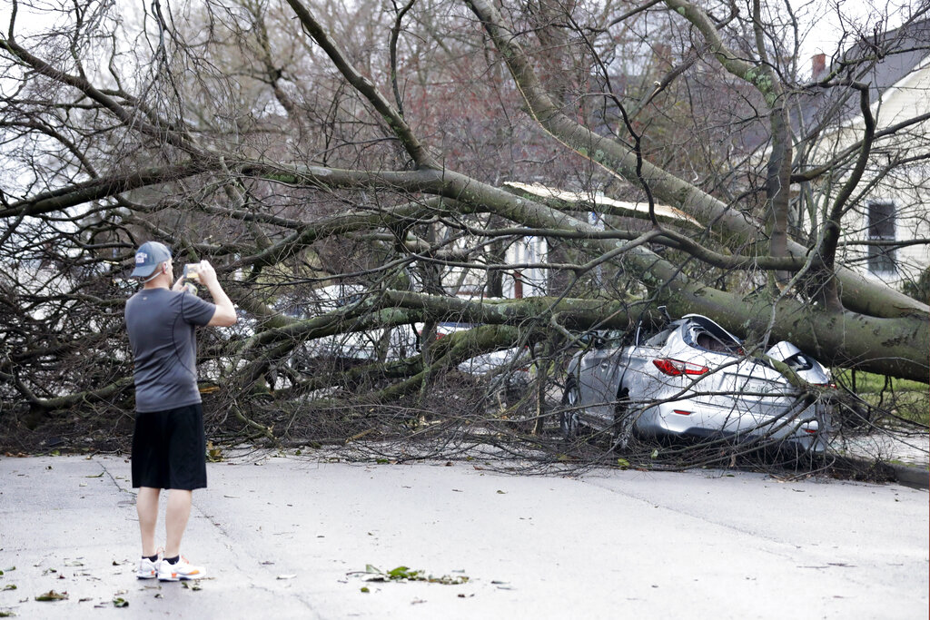
Notes:
Let’s look locally, now. In the last few months our area has suffered an 80-mile swath of destruction in a tornado that ripped up thousands of big trees, as well as the lives of the people.
Then came another uncommon weather phenomenon, straight-line winds that knocked out more trees and the power for more than 200,000 people for up to 5 days.
One aspect of climate change is more storms and greater intensity of the storms.
Credit: A resident photographs damage after a tornado touched down Tuesday, March 3, 2020, in Nashville, Tenn. (AP Photo/Mark Humphrey)

Slide 11
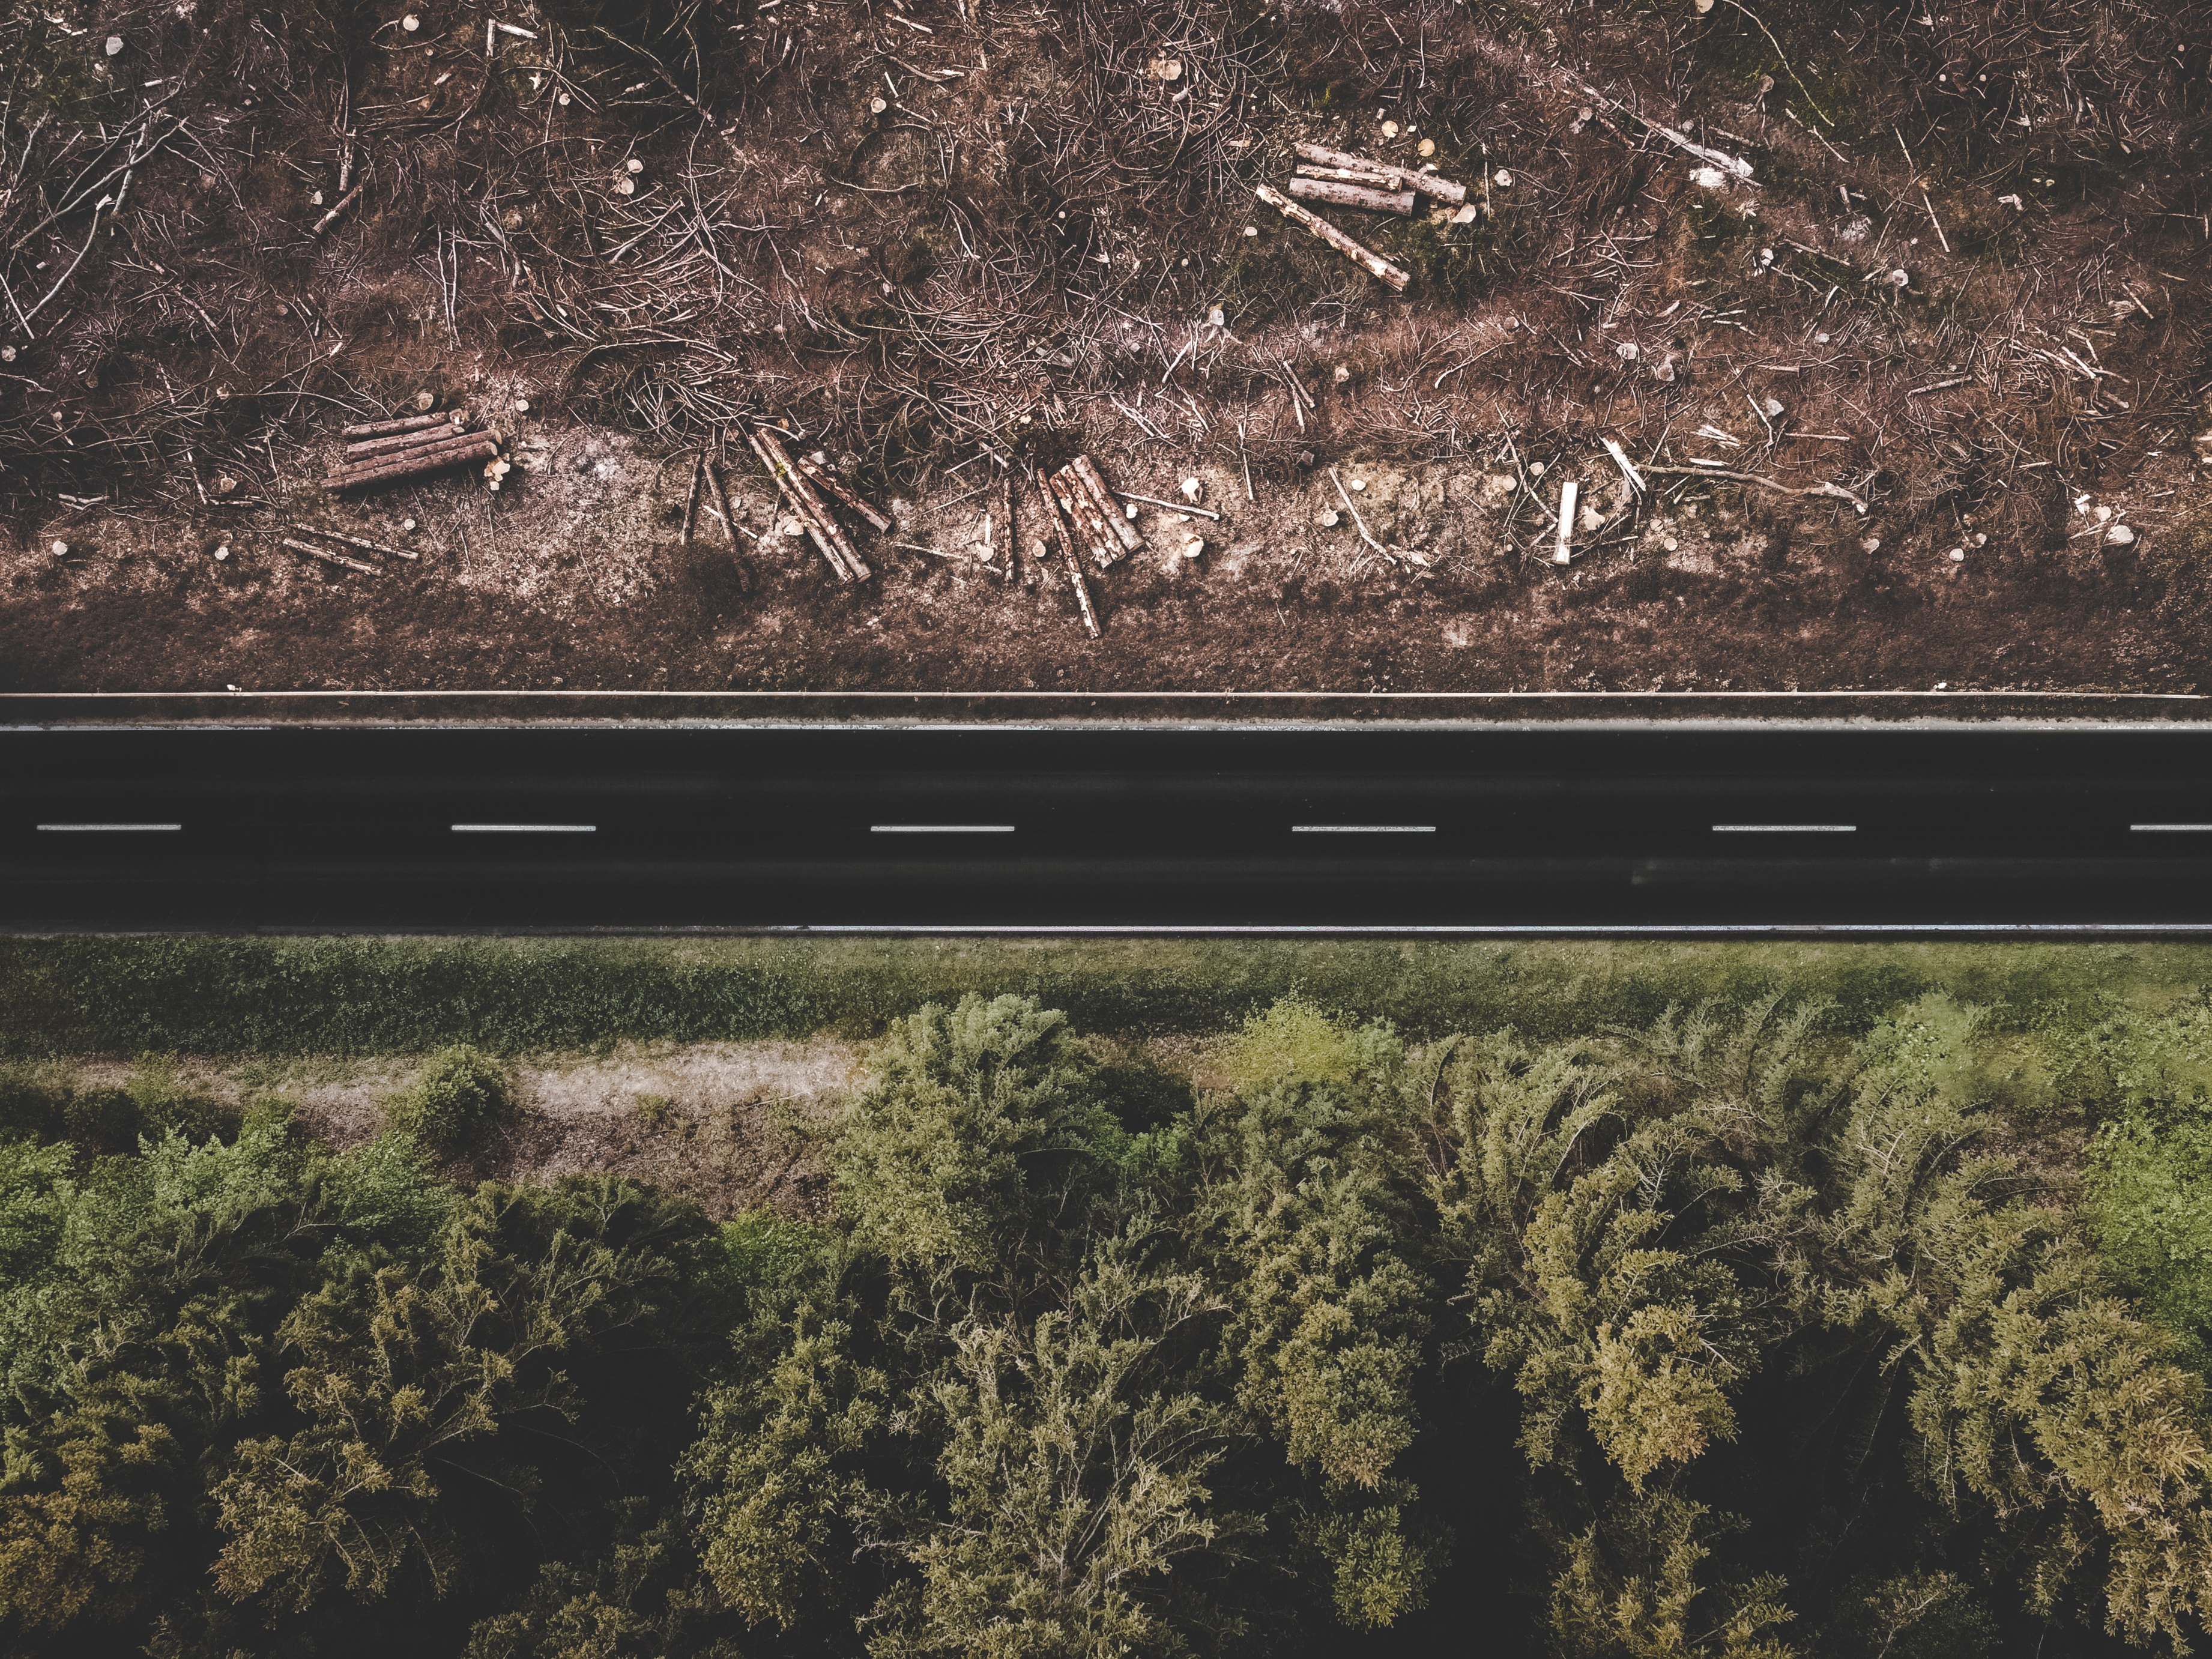
Notes:
And those losses are on top of other tree losses for Nashville. Development pressure, for example.
Remember I-440 before the construction? Now, we’ve gained more lanes of traffic but lost the trees on the now-gone median that used to mitigate our emissions.

Slide 12
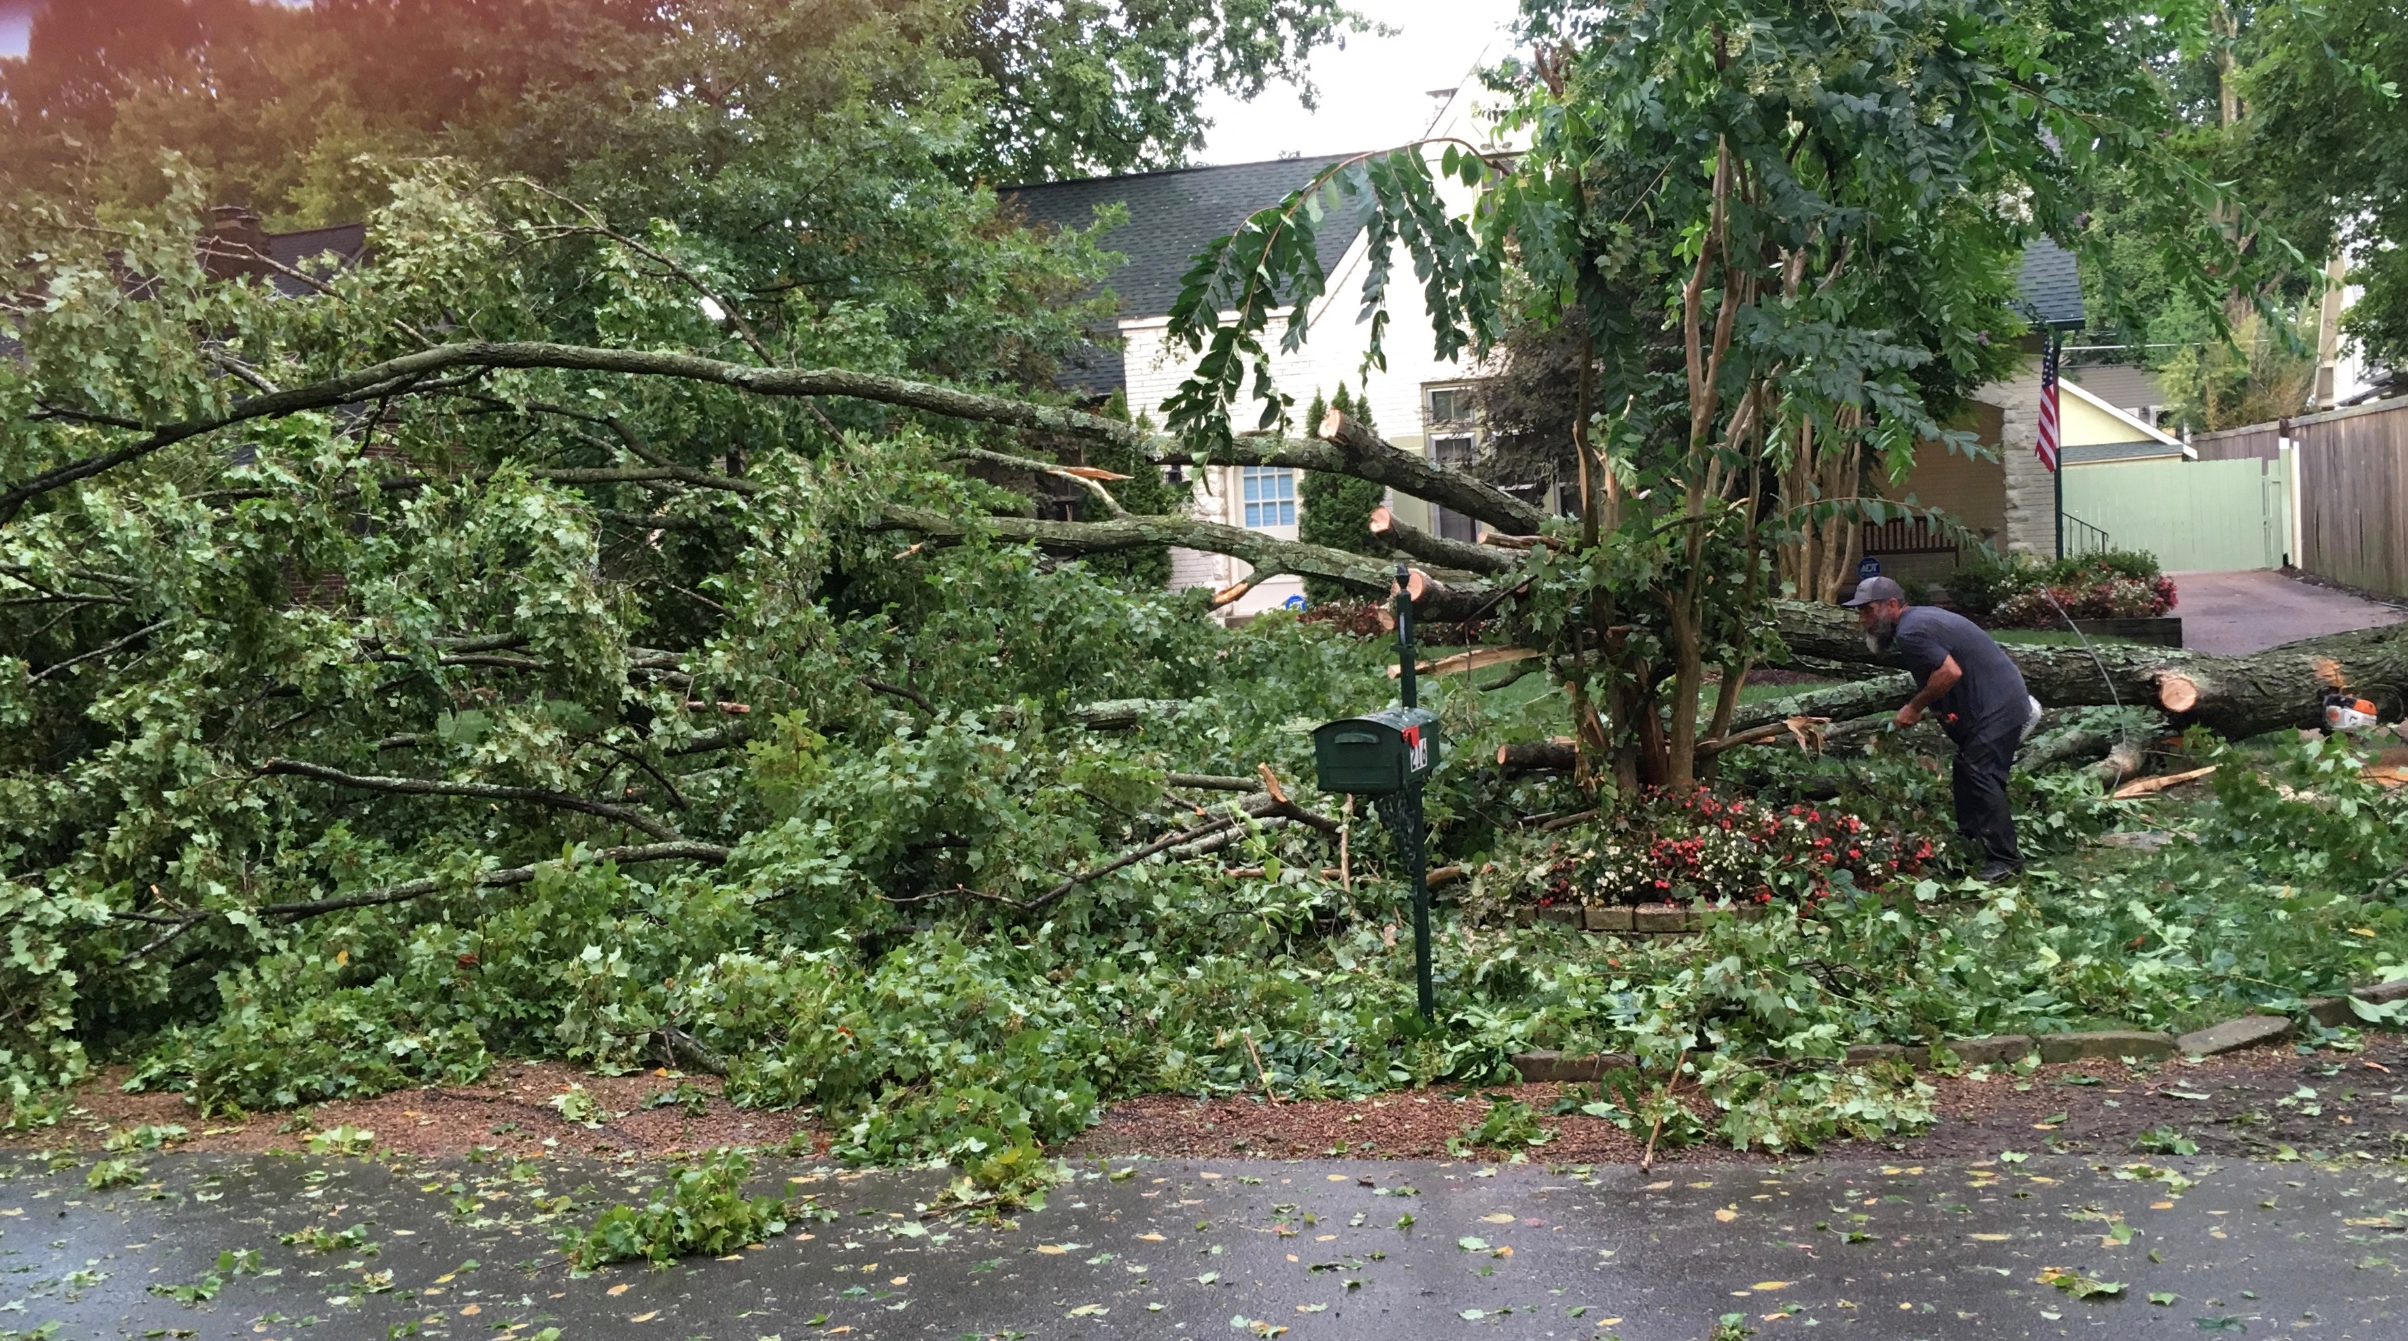
9,000 lost annually in Nashville
Notes:
In addition to development and storms, tree diseases and old age have taken a big toll. On my 2-block street alone, we have lost 14 big trees in less than 4 years. Urban trees last on average about 100 years. My neighborhood was developed in 1928.
Overall, Nashville has been losing an estimated 9,000 trees per year for the last 10 years. We are deforesting too.

Slide 13

Notes:
So why plant trees? Because…
Globally, trees are one way God provides for us to all breathe easier. Removing air pollution—major factor in asthma and COVID.
Emissions go down, greenhouse gases reduce, global warming drops, climate change slows.

Slide 14
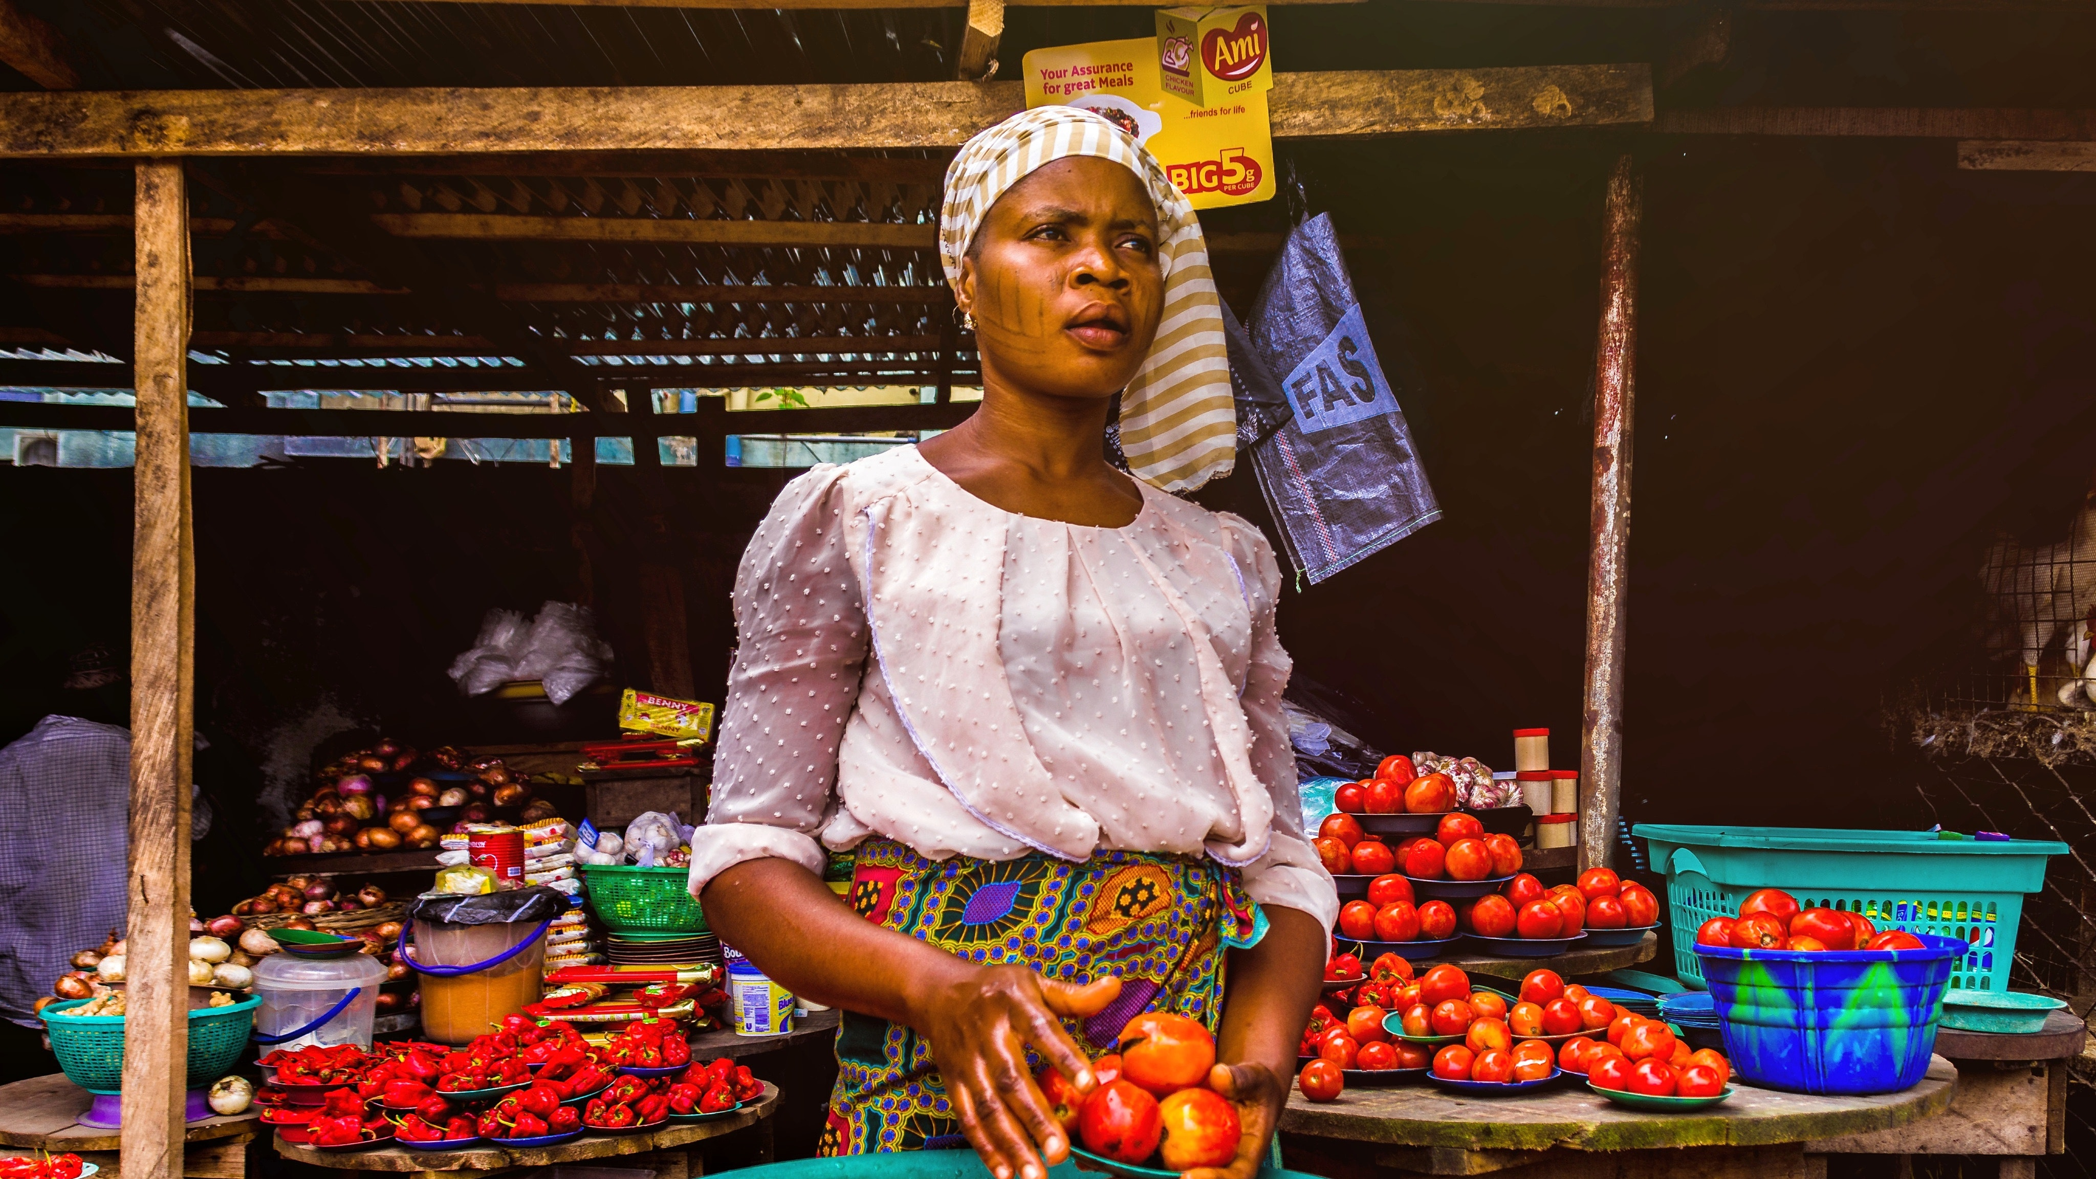
Notes:
Globally, reforestation does more than just add trees to the landscape. It also affects the quality of the soil, increasing the community’s food and economy and tamping down the need to fight over scarce resources. It also helps to free people, women and girls especially, to invest their efforts into education and a better quality of life.

Slide 15
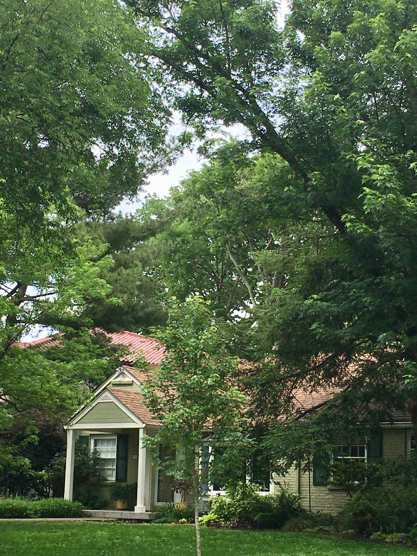
City Trees—
Cool the urban core
Reduce energy bills
Defend against storm water runoff
Dampen noise
Increase property values
Make neighborhoods safer
Contribute beauty to our lives
Notes:
Locally, trees not only improve air quality, but also cool the urban core, reduce home energy bills, defend against storm water runoff, dampen noise, increase property values, make neighborhoods safer, and contribute beauty to our lives.

Slide 16
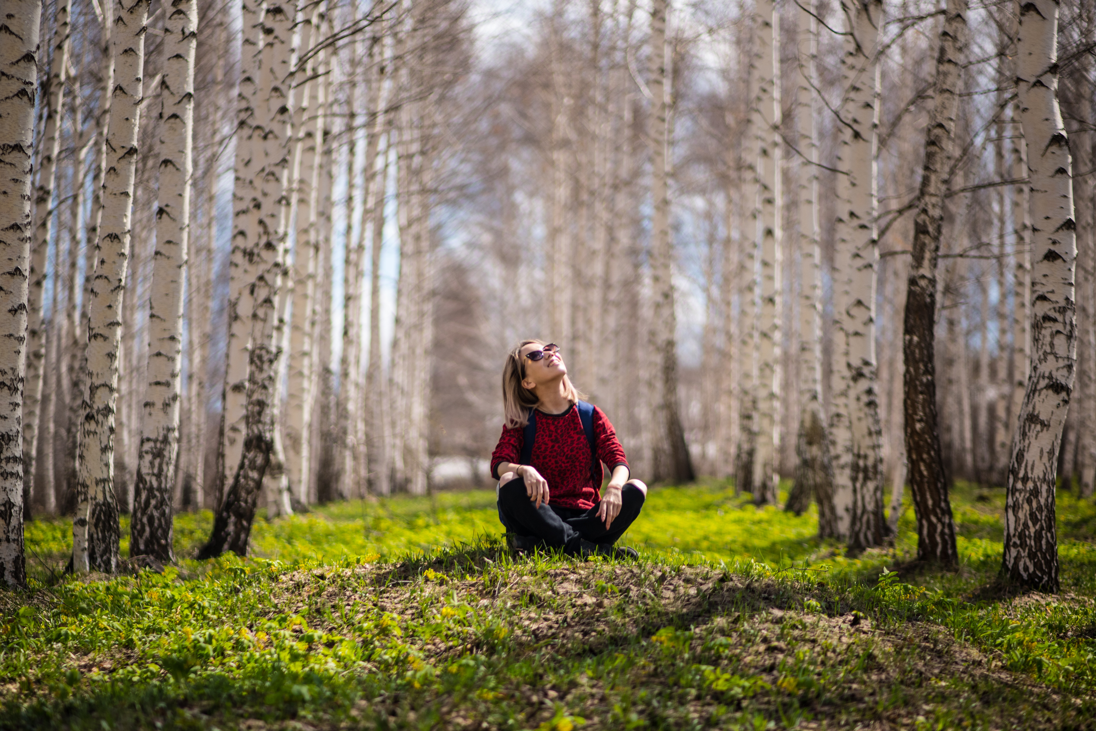
What
can I
possibly
do?
Notes:
With so many new trees needed all around the world, the problem may seem overwhelming, but there are things you can do to plant for now and for a better future.
Globally, several reputable organizations are engaged in reforestation projects. You can donate funds and know that your dollars will plant more trees. (I donated $50 in honor of my son-in-law's 50th birthday. That gets 50 trees planted in Uganda.)
Locally, consider planting more trees where you are—your home, your business, your neighborhood or your condo association, your city, and beyond. Let me tell you my story…

Slide 17
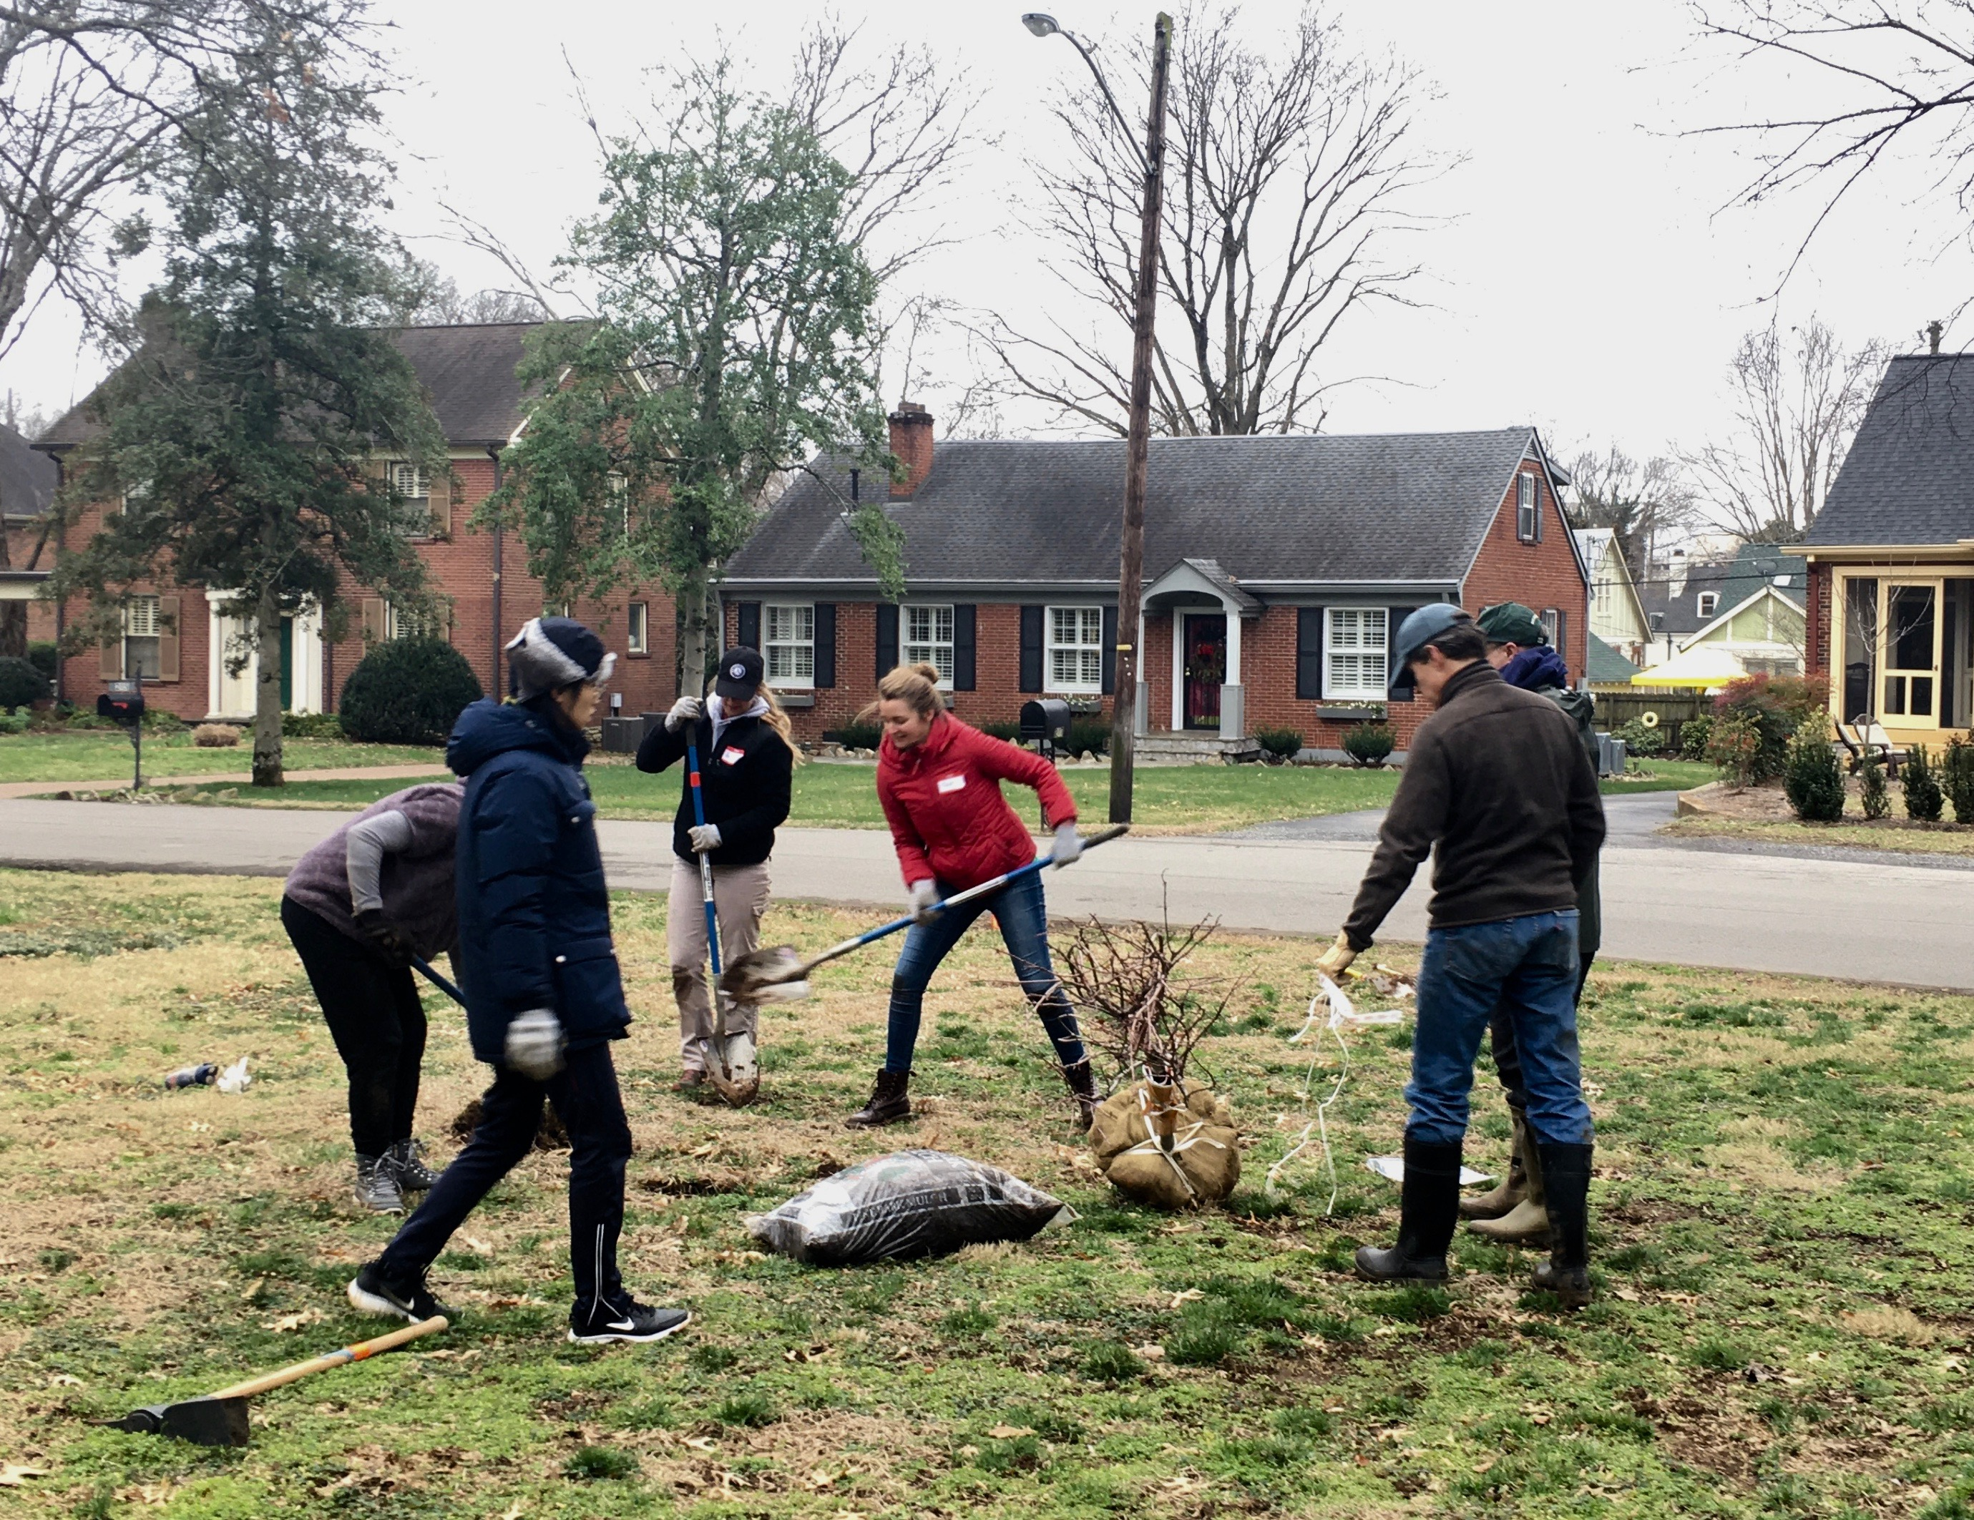
Notes:
My story: These are my neighbors planting a new tree in my front yard this past January.
One of them, John, and I had bemoaned the loss of our big trees and decided to do something. The first person I talked with was Robin Bible, who lives in the neighborhood next to mine. Richland-West End has been planting trees regularly for 30 years, and the neighborhood is spectacular, especially in the spring with all the blooms.
Robin steered John and me to some of the great resources we have in Nashville for planting trees. I’ll send you the listing.
Choosing Nashville Tree Conservation Corps, we embarked on a campaign to encourage our Cherokee Park neighborhood to plant. The results? 16 new trees!

Slide 18
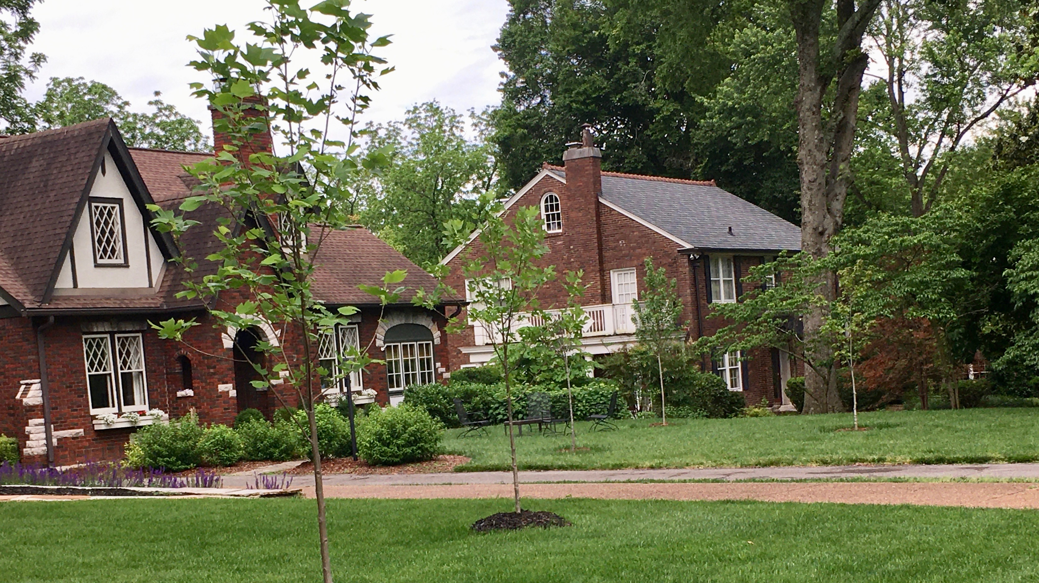
Notes:
Here are 5 of the 7 new ones on just our street that the neighborhood volunteers planted for us.
John and I are committed to a second push to plant more trees this coming fall.

Slide 19

Reduce your consumption of trees
Notes:
We’ve looked globally and locally, and now we’re going to meddlin’! Here are some very practical tips for reducing your day-to-day consumption of trees at home, school, or the office:
Start by looking at paper—not as “just paper”—but as a tree.
Buy recycled paper; help create the market
Recycle paper every time
Print 2-sided
Be intentional about using up scrap paper
If you need to shred paper, you can compost it since it will not recycle. Shredded paper is too small and falls through the recycling machinery.
Switch from paper napkins to cloth napkins, from paper towels to usable rags that you can wash and reuse.

Slide 20

Wiped Out!
27,000 trees every day!
Notes:
Now, we’re really meddlin’. Let’s look in the bathroom. Even there you can conserve trees.
Choose your toilet paper wisely. 27,000 trees are wiped out every day for our wiping needs.
Look instead for brands made from 50% recycled paper (good) or better 100% from recycled paper.
Do not by any brand that admits to using virgin forests (Charmin, Cottenelle, Northern, for example).
Try out TP made from bamboo. Trees take up to 30 years before harvest; bamboo takes months. It is a very sustainable source for paper (and now even clothing and more).
Switch to a bidet or to cloth. Yes, that’s possible and better for the environment.
My favorite is Who Gives a Crap. They have both 100% recycled and TP made from bamboo. And they put 50% of their profits to work building toilets for people without adequate sanitation in developing countries. Besides that they’re fun!
Paper Towels too!

Slide 21
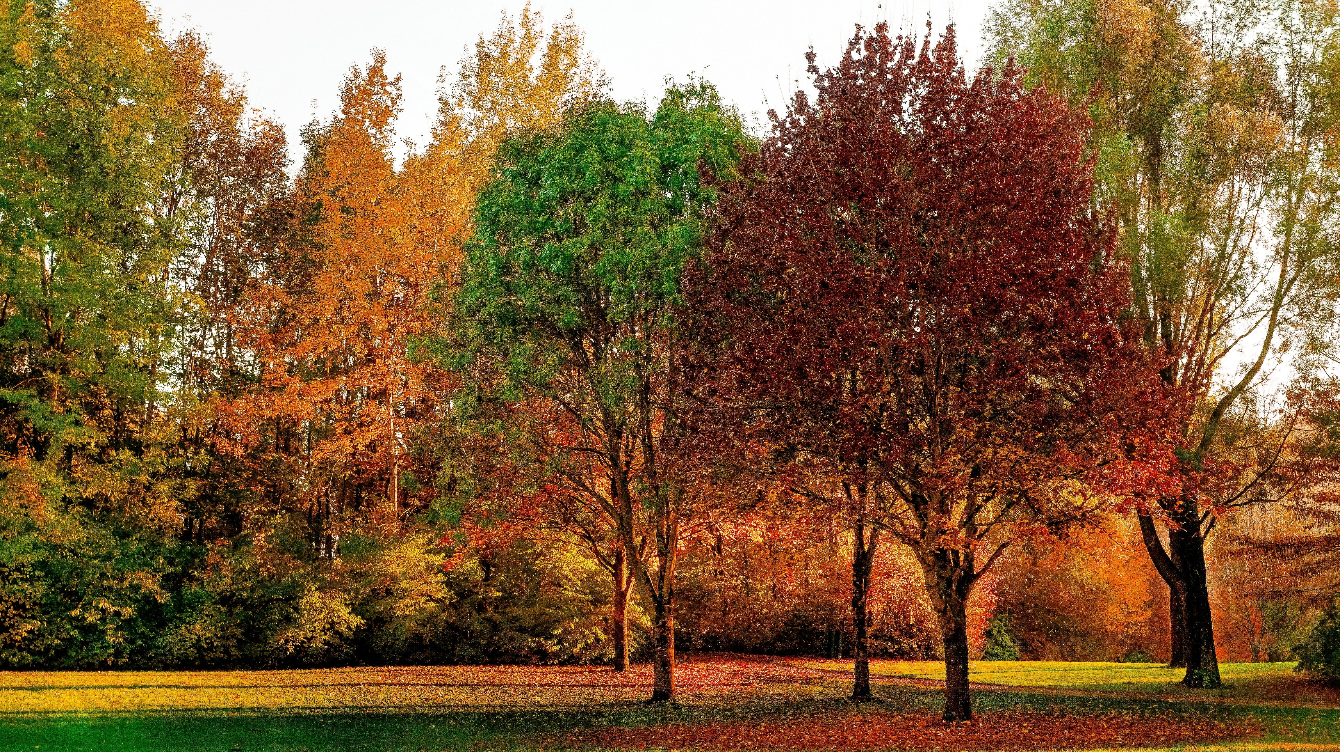
Notes:
God has given us a beautiful planet, and an amazing tree system that works well. Because God has also given us lungs, we can relate to that system of inhaling and exhaling.
Because we have lungs, we can also understand the consequences of having those lungs depleted or damaged.

Slide 22
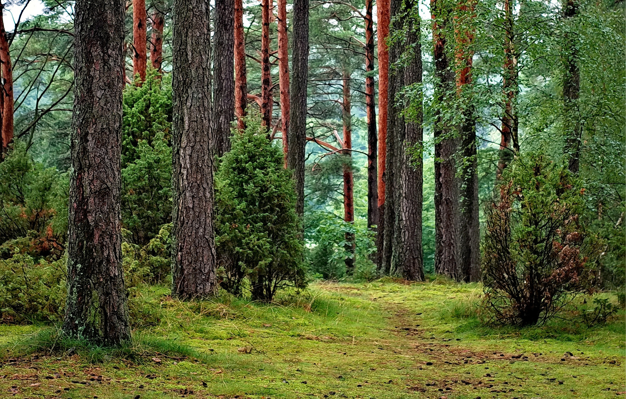
Notes:
The path ahead for us is to recognize trees as living, breathing creations of God that are wonderful in their own right and also crucial to humanity’s well-being.
The challenge for us is to claim our role as God’s stewards and care for them—globally, locally, and even in our own homes—indeed, in all the places and ways we live.

Slide 23
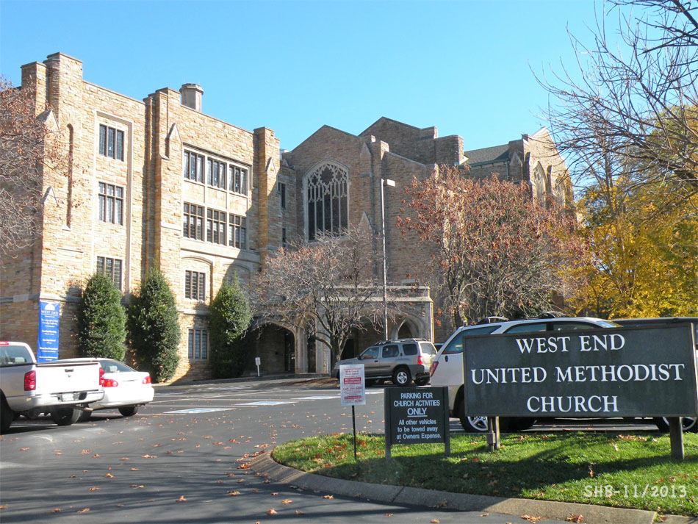
Notes:
At West End we are blessed by having an unusual number of trees in our parking lot. Look around and give thanks when you are there for the faithful stewards who had the vision to plant them years ago.
Conserving and planting trees are actions we all can do to honor our love of God and of neighbor—both now and in the future.

Slide 24

Your Turn!
What surprised you?
What excited you?
What will you commit to doing?

